Slide 1
EOP Enrollment capacity and Reports
Career Coach Training
September 29-30, 2021

Slide 2
EOP program(s) Statement of Work
Portland EOP Career Coaching Program
Enrollment capacity Includes Intensive phase participants and actively engaged participants in Retention and Advancement phase. Participants must meet the eligibility requirements of the Portland EOP. | 100
Success Measures | Goal
Attainment of Unsubsidized Employment | 70%
Attainment of Career Track Employment | 60%
Retention in Employment | 70%
Advancement in employment as demonstrated by gain in earnings, wage or benefits. | 50%
DCJ Career Coaching Program
Enrollment capacity Includes Intensive phase participants and actively engaged participants in Retention and Advancement phase. Participants must meet the eligibility requirements of Multnomah County DCJ. | 35
Success Measures
Attainment of Unsubsidized Employment | 60%
Attainment of Career Track Employment | 35%
Retention in Employment | 70%
Advancement in employment as demonstrated by gain in earnings, wage or benefits. | 50%
Additional Measures
Completion of Work Experience, OJT or Occupational Skills Training | 20%
Average hourly earnings | $13.00

Slide 3
Enrollment capacity
Intensive Phase participants receiving program and support services.
Retention and Advancement Phase participants receiving program and support services.

Slide 4
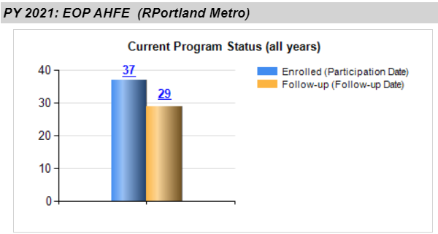
How to calculate your enrollment capacity
To find a number of enrolled participants go to I-Trac Reports tab. Select the program year in which data will be pulled (PY21) and a provider name.
EOP program dashboard report blue column shows enrolled participants who received a service in Intensive services program phase.

Slide 5
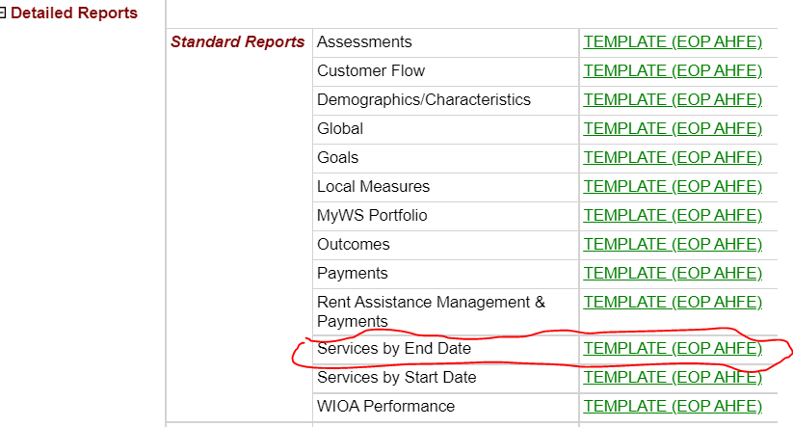
How to calculate your enrollment capacity
To find a number of actively engaged participants in Retention and Advancement phase go to I-Trac Reports tab. Select the program year in which data will be pulled (PY20) and a provider name.
Select Services by the End Date Report from the list of Detailed Standard Reports.

Slide 6
How to calculate your enrollment capacity
Select follow-up services total to open up customer list report page (Customer list not included for security purposes).
Number of customers received follow up services is displayed in the report header.
Fill vacated slots within three months to maintain enrollment capacity.
Enrolled customers
Customers receiving follow up services
Enrollment capacity

Slide 7
Customer name | Date | Follow up note | Service | Include in enrollment capacity
Customer A | Exited into employment 4-30-21 Q1 confirmation-7-21-21 | Customer is still employed
 | Q2 confirmation 10-01-21 | Customer is working. Wage increase. Making $17 an hour
Customer B | 8-25-21 | Customer lost his job. Coach met with customer to review and update resume.
 | 9-29-21 | Customer needed assistance with rent assistance. Started referral process.
Customer C | 9-5-21 | Customer had conflict with coworker. Helped to resolve the issue.

Slide 8
EOP Reports
Small group discussion:
( choose the person to report back )
What reports do you use if any?
What are the most useful reports?
What information you need but do not know where to find it in I-Trac?

Slide 9
All I-Trac users have access to reports.
Reports are permission based and restrict users only the provider and fund.
Coaches are granted access program I-Trac customer records and reports upon I-Trac training completion. No special permission to report access needed.
Reports Home Page consist of EOP Dashboard Report and Detailed Reports selection Section.

Slide 11
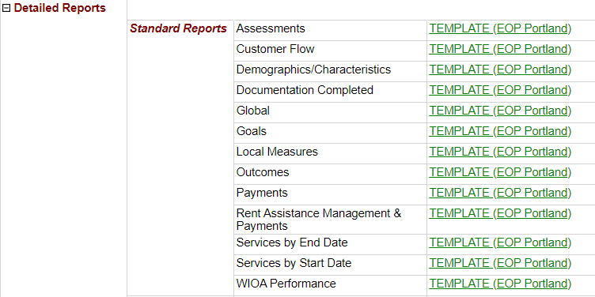

Slide 12
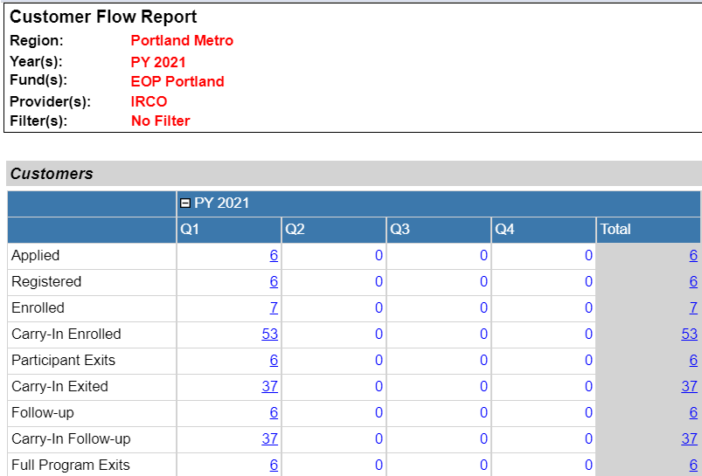

Slide 13
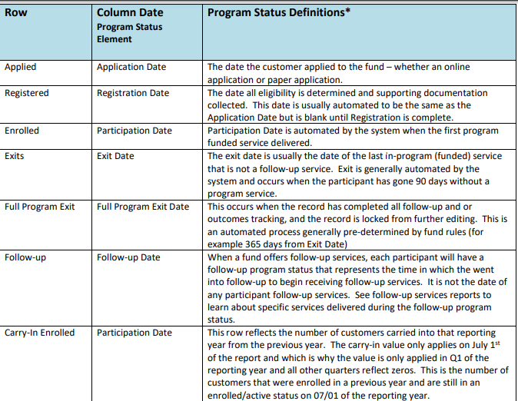

Slide 14
Demographic/Characteristics Report ( individual assignment-5 min).
Select and review your program PY 20 Demographic/Characteristics report
What have you learned?
How can report data help you to manage your caseload and enrollment?

Slide 15
My supervisor is presenting EOP at our agency Board of Directors meeting. I was asked to provide the following data for the presentation:
How many participants started and completed occupational trainings?
How many Career Mapping Workshops program staff conducted
How many participants received support services?
How many participants were employed at the registration?
How many participants were homeless at the registration?
How many people of color were enrolled in EOP?
HELP! HELP! HELP!

Slide 16
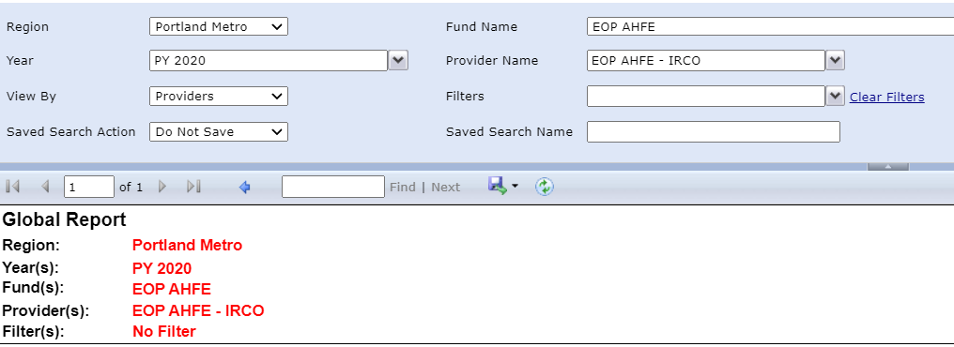
I-Trac EOP Global report review

Slide 17
Questions?

