Slide 1

Referral Process for
Our Just Future Hub
Today is a basic presentation. A data entry training is happening on Sept 28 from 1-3 pm. You also can request a more in-depth ITrac data entry training with Jennifer or Daryl. To learn more about the OJF Hub, schedule an hour-long OJF Hub Orientation with Sayra.
PART 1: HOW THE HUB ACCEPTS REFERRALS
PART 2: HOW TO REFER TO THE HUB

Slide 2
Referral Process for Our Just Future Hub
PART 1: HOW OJF HUB ACCEPTS REFERRALS
WHO? APN & 6 PROVIDERS: Central City Concern, Constructing Hope, Our Just Future, IRCO, Oregon Tradeswomen, SE Works
WHEN? Depending on staff capacity, referrals are requested every 1-2 weeks.
HOW? Sayra emails all coaches that send referrals to OJF Hub. The email tells how many referrals each provider can send.
# OF REFERRALS
The number depends on the annual budget and staff capacity at OJF. Generally, OJF Hub accepts about 100 referrals per year total. How many referrals each provider gets depends on how many career coaches are at that provider.
$$ OF RENT ASSISTANCE
Keep in mind that it is best practice to NOT give the maximum amount of help to EVERY participant. If participant only needs 2 months, then give just 2 months. Otherwise, we will run out of money too soon.
Want to learn more?
Schedule an hour-long OJF Hub Orientation with Sayra!

Slide 3
Referral Process for Our Just Future Hub
PART 2: HOW TO REFER TO OJF HUB
Thanks to everyone for working with us
on this new process using the new ITrac Rent Assistance fund.
We are all learning new data entry in ITrac.
The following slides include all the steps for an OJF Hub referral. Some slides cover the data entry Worksystems requires you to do, but today we are focusing on the OJF Hub referral parts of the process and not the data entry.
Again, if you want to know more about the data entry slides, request a training with Jennifer or Daryl.

Slide 4
Referral Process for
Our Just Future Hub
Coach creates ITrac Rent Assistance record & completes Registration tab.
Each month coach copies service by the 10th of the month BEFORE OJF can pay rent.
Advocate enters payment & service in RA record.
OJF advocate contacts client, does intake.
Advocate emails coach RA plan.
Coach emails referral@humansolutions.org & uploads Career Plan via ITrac File Exchange.
To accept referral, Hub reviews Registration tab & enters Hub’s first service within 3 days.
Coach copies first service!

Slide 5
Referral Process for Our Just Future Hub
PART 2: HOW TO REFER TO OJF HUB
TEN STEPS
Serve your customer and ENTER SERVICES.
Decide if your customer needs Rapid Rehousing or Homeless Prevention.
Create the ITrac Rent Assistance Record.
Complete data entry on the Registration tab.
Complete Application (located on Customer Documents Menu).
Upload the Career Plan via ITrac File Exchange.
Email referral@humansolutions.org.
Wait three business days.
Look in the Rent Assistance record to see if OJF Hub has 1) accepted the referral and 2) entered the OJF Hub’s first service.
COPY THE SERVICES TO THE NEW RENT ASSISTANCE RECORD!
Questions? Refer to ITrac Rent Assistance Data Entry Guide.
  Call Jennifer Fox with data entry questions: 503-936-7050
  Email Sayra Rodriguez with referral questions: srodriguez@humansolutions.org

Slide 6
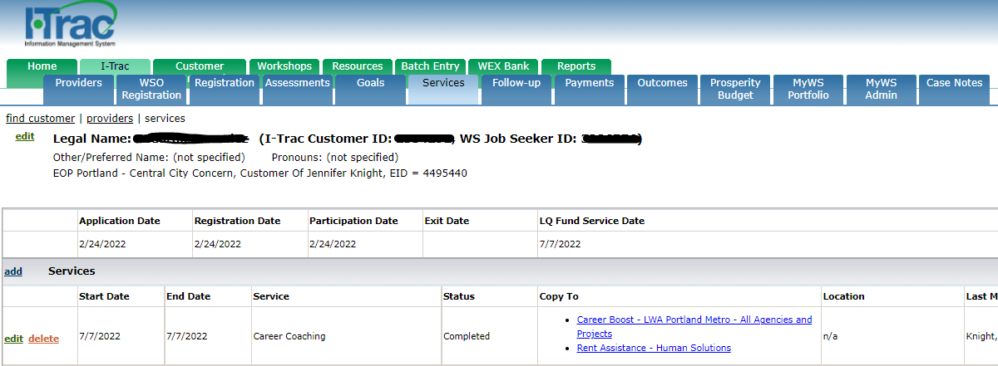
Referral Process for Our Just Future Hub
PRT 2: HOW TO REFER TO THE HUB
PART 2: HOW TO REFER TO OJF HUB
Serve your customer and ENTER SERVICES.

Slide 7
Referral Process for Our Just Future Hub
PART 2: HOW TO REFER TO OJF HUB
Rapid ReHousing
Rapid ReHousing services quickly connect households experiencing homelessness to permanent housing. Rapid ReHousing provides short-term rental assistance and career coaching services. The goals are to help people obtain housing quickly, increase self-sufficiency and remain housed. Rapid ReHousing services are provided to individuals that are currently experiencing homelessness or fleeing domestic violence.
2. Decide if your customer needs Rapid ReHousing or Homeless Prevention.
Homeless Prevention
Homeless Prevention services help prevent households at risk of becoming homeless from actually becoming homeless. Homeless Prevention provides short-term rental assistance and career coaching services. The goals are to help people retain their housing to prevent them from becoming homeless. Homelessness Prevention services serve individuals that currently have housing or live in an apartment, but who are facing eviction or who may be at risk of becoming homeless.
Rapid ReHousing
Customer currently experiencing homelessness or fleeing domestic violence.
Helps people obtain housing quickly
Provides short-term rental assistance and career coaching services
Homeless Prevention
Customer currently has a house or lives in an apartment.
Helps people stay housed
Provides short-term rental assistance and career coaching services

Slide 8
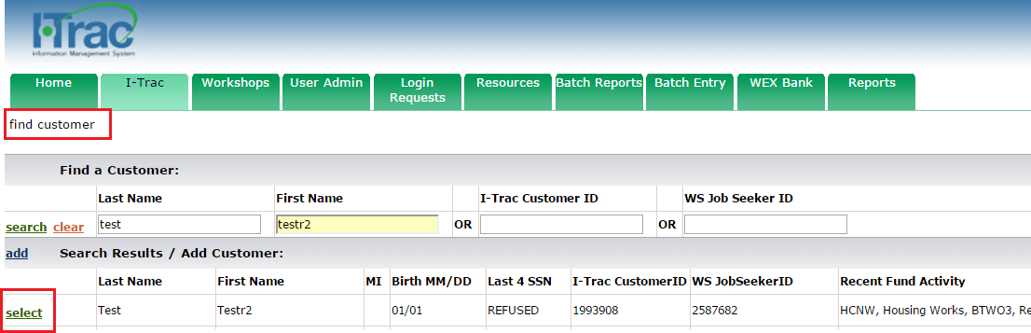
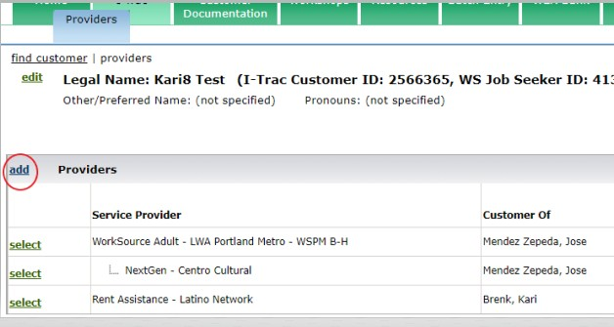
Referral Process for Our Just Future Hub
PART 2: HOW TO REFER TO OJF HUB
3. Create the ITrac Rent Assistance Record.
Find the participant in I-Trac.
Using Find Customer, search for the participant record by Name, I-Trac Customer ID or WS Job Seeker ID and click Select. Confirm Birth MM/DD and Last 4 SSN (if available) that show to verify that you are selecting the correct participant in I-Trac.
On the Providers Tab, click add in Providers Control to add the Rent Assistance enrollment record.
  Service Provider = Rent Assistance- Choose the HUB provider you are referring the participant to for rent assistance.
  Customer Of = Choose Your Name. Keep the Customer Of name as the Career Coach making the referral, do not change to be a specific HUB staff.
  Application Date = The date the customer is completing the registration process (NOTE: This date must be before the date of the first Rent Assistance grant funded service).

Slide 9
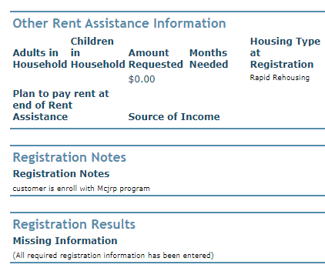
Referral Process for Our Just Future Hub
PART 2: HOW TO REFER TO OJF HUB
4. Complete data entry on the Registration tab.
Review fields that may auto-import:
Address Phones Email Address Ethnicity Race Other Demographics
Employment Characteristics- To be eligible must be Homeless or Housing Insecure
Employment Status Public Assistance
Complete these fields:
Co-enrollment- choose from the dropdown other programs the participant is actively enrolled in. This is important to complete as it filters into reports.
Six Month Income- complete for current income
Other Rent Assistance Information
  Adults in Household
  Children in Household
  Source of Income
  Amount Requested- Enter the monthly amount of rent requested
  Months Needed
  Housing Type at Registration – Choose Rapid Re-Housing or Homeless Prevention as defined in the Rent Assistance Regional Program Standards
Registration Notes
REGISTRATION NOTES FIELD
EXAMPLE OF WHAT TO INCLUDE
Participant is at risk of homelessness because he has rec’d an eviction notice. He needs 4 months of rent assistance for August $800; Sept $800; Oct $400; and Nov $300. Right now, I am helping them enroll in a truck driving training.

Slide 10
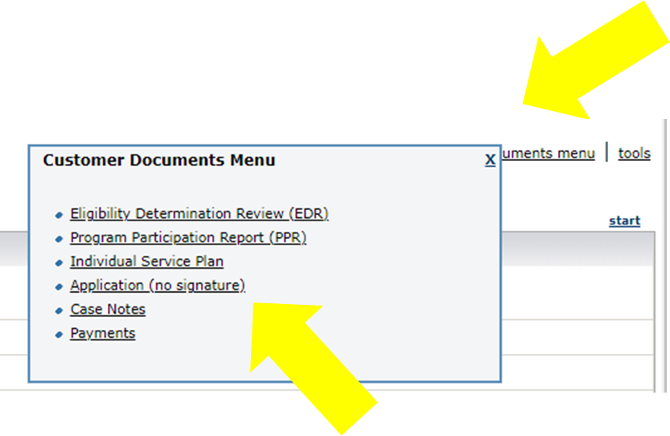
Referral Process for Our Just Future Hub
PART 2: HOW TO REFER TO OJF HUB
5. Complete Application (located on Customer Documents Menu).
PRO TIP! Be sure to complete ALL the fields.

Slide 11
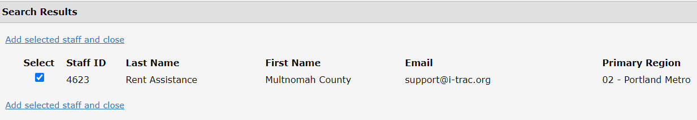
Referral Process for Our Just Future Hub
PART 2: HOW TO REFER TO OJF HUB
6. Upload the Career Plan via ITrac File Exchange.

Slide 12
Referral Process for Our Just Future Hub
PART 2: HOW TO REFER TO OJF HUB
7. Email referral@humansolutions.org.
Referral email template
Hi EOP Team
I am referring I-Trac #________for rent assistance. I completed the referral process in I-Trac and uploaded a career plan via I-Trac file exchange.
(Insert career coach name)
(Partner Agency name)
Please Note** The Rent Assistance Advocate will enter a review date in registration tab when she has accepted the referral and 2) The Rent Assistance advocate will have three business days to enter the OJF Hub’s first service.
The EOP Family Advocate will notify career coach when the service has been entered. Lastly, Career Coach will notify the assigned Family Advocate when a service has been copied in ITrac for the advocate to move forward with contacting participant for an intake.

Slide 13
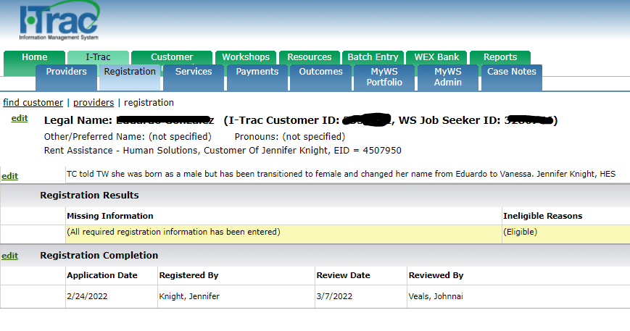
Referral Process for Our Just Future Hub
PART 2: HOW TO REFER TO OJF HUB
Wait three business days.
Look in the Rent Assistance record to see if OJF HUB has 1) accepted the referral and 2) entered the OJF Hub’s first service.

Slide 14
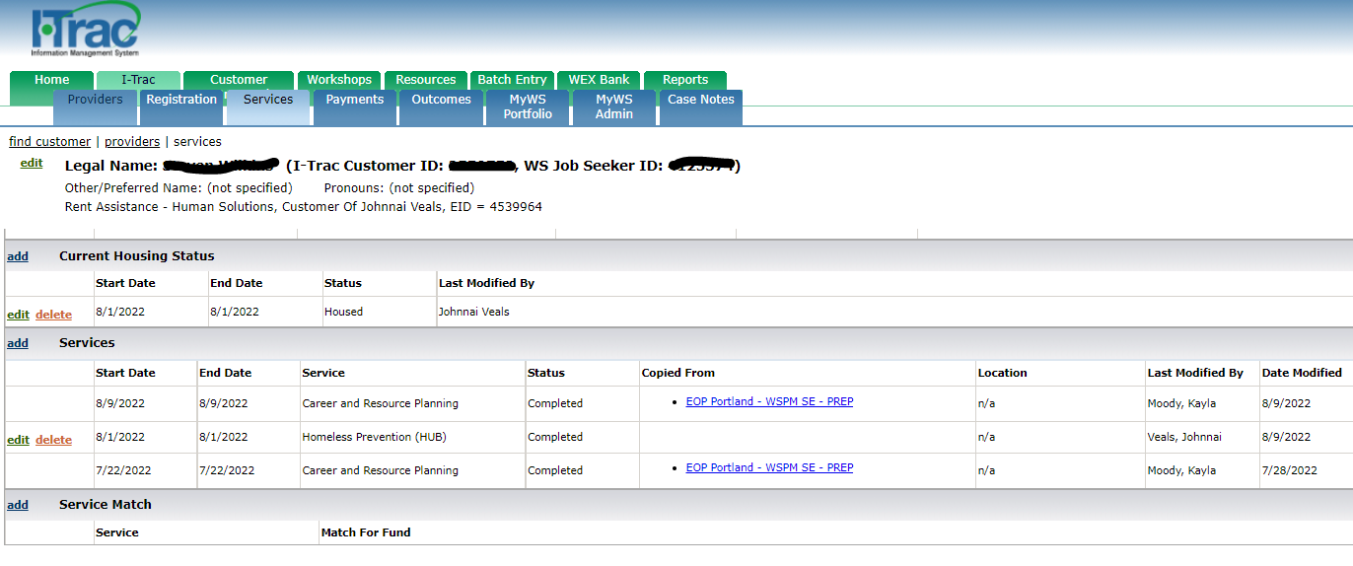
Referral Process for Our Just Future Hub
PART 2: HOW TO REFER TO OJF HUB
Wait three business days.
Look in the Rent Assistance record to see if OJF HUB has 1) accepted the referral and 2) entered the OJF Hub’s first service.

Slide 15
Referral Process for Our Just Future Hub
PART 2: HOW TO REFER TO OJF HUB
COPY THE SERVICES TO THE NEW RENT ASSISTANCE RECORD!
To be referred to and receive rent assistance, participants must be engaged with their Career Coach in each month that the participant is receiving rent assistance as defined in the Rent Assistance Regional Program Standards. Service engagement must be entered by the 10th day of each month in each month the participant is searching for rent assistance, and then each subsequent month that rent assistance is received until rent assistance ends. OJF Hub can’t pay rent without verifying engagement! Engagement is verified for the current month and rent is paid in the current month for the next month.
Questions? Refer to ITrac Rent Assistance Data Entry Guide. Then call Jennifer Fox: 503-936-7050

Slide 16
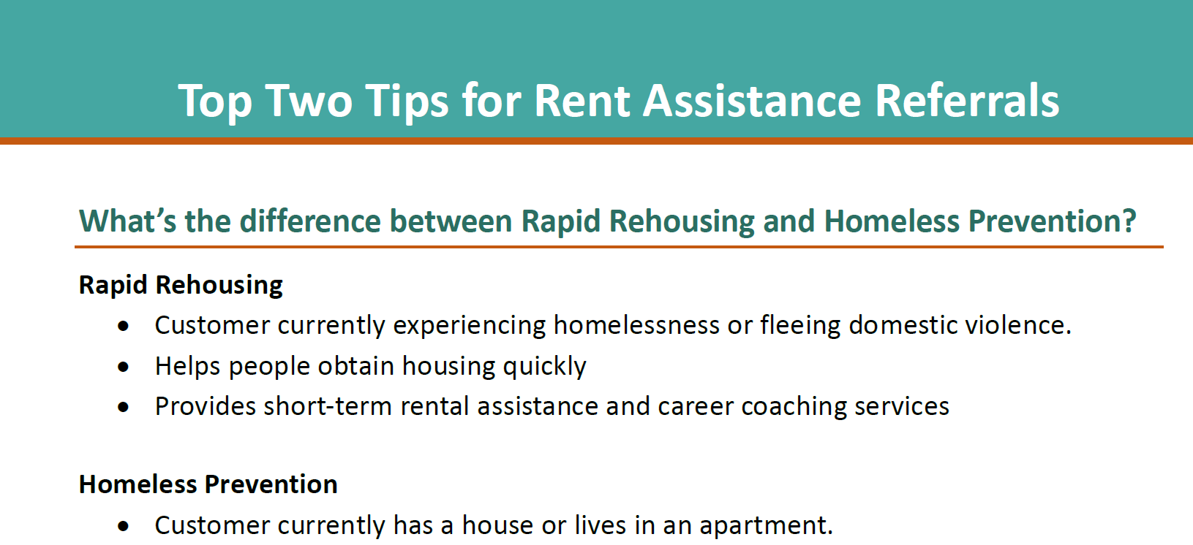
Referral Process for Our Just Future Hub
PART 2: HOW TO REFER TO OJF HUB
TOP TWO MISTAKES
Difference between rapid rehousing and homeless prevention. See slide #7!
Forgetting to enter services and/or copy services. See slide #15!
Questions? Refer to handout “Top Two Tips for Rent Assistance Referrals.”

Slide 17
Referral Process for Our Just Future Hub
MORE TRAINING?
Want to learn more about how OJF process referrals?
Schedule an hour-long OJF Hub Orientation with Sayra!
Sayra Rodriguez || srodriguez@humansolutions.org
Want to learn more about ITrac data entry in the new Rent Assistance fund?
Schedule an hour-long data entry training with Jennifer or Daryl!
Jennifer Fox|| jfox@worksystems.org
Daryl Lambert|| dlambert@worksystems.org

