Slide 1
ITrac Data Entry for Staff Who Work at Rent Assistance Hub
Rent Assistance Hub Regional Program Standards
Trivia Questions
https://app.sli.do/event/j9yzSXNFPkVY9H1apeYMV3
Enter code 3232934
Notes:
Kari16 Test (I-Trac Customer ID: 2585777, WS Job Seeker ID: 4160464)

Slide 2
ITrac Data Entry for Staff Who Work at Hub
IMPORTANCE OF DATA ENTRY
Worksystems contracts with Central City Concern, Latino Network and Our Just Future to provide rent assistance to participants. We pay the rent with money from funders.
Our funders want to know how we spend their money and the impact of their money on participants’ lives. You enter data into ITrac so we can send reports to our funders. Your data entry helps us get more funding!
CONTRACT PERFORMANCE MEASURES
SUCCESS MEASURE | DETAIL/METHODOLOGY
Enrollment | Number of participants enrolled in the Rent Assistance program.
Housed at Exit | Number of participants with a Housing Status of Housed at Exit.
Individuals Served with Rapid Re-Housing | Number of participants served with a Housing Type at Registration of Rapid Re-Housing.
Individuals Served with Homelessness Prevention | Number of participants served with a Housing Type at Registration of Homelessness Prevention.
Housing Retention for 6 months | Of all Rapid Re-Housing/Homelessness Prevention participants, those that retain housing for a full 6 months after rent assistance ends.
Housing Retention for 12 months | Of all Rapid Re-Housing/Homelessness Prevention participants, those that retain housing for a full 12 months after rent assistance ends.

Slide 3
ITrac Data Entry for Staff Who Refer to Hub
OVERVIEW OF WHAT COACHES DO
Create Record
Do Registration
Sign & Save Application
Upload & Save Docs
Find customer
Select customer
Add Rent Assistance Provider
Click Registration Tab
Enter info
Do ‘Registration Completion’
Go to Customer Documents Menu
Print application and upload signed application or request an electronic signature on application
Click on green Customer Documentation Tab
Find customer
Upload Career plan
Save an updated Prosperity Planner Budget
Email Hub Referral
Confirm Acceptance
Copy First Service
Copy Next Services
Latino Network: info@latino.net
Our Just Future: referral@ourjust future.org
Wait 3 days
Open customer’s Rent Assistance Record
Has Hub entered its first service?
Open customer’s record with you
Enter service
Select Hub to copy service
Open customer’s record with you
Enter MONTHLY service
Select Hub to copy service

Slide 4
ITrac Data Entry for Staff Who Work at Hub
OVERVIEW OF WHAT HUB STAFF DOES
Evaluate Referral
Accept or Reject Referral
Enter First Hub Service
Assign Hub Staff
Referral Email
Registration Tab
Application
Current Career Plan
Current Prosperity Planner Budget
To accept, enter Review Date & Reviewed By on Registration Tab
To reject, enter Pre-Program Exit on Outcome Tab, enter a case note with explanation why
Go to Services Tab
Enter Rapid Rehousing or Homelessness Prevention
Go to Providers Tab
Change Customer Of to Hub Staff Name
Email Referral Coach
Confirm First Coach Service
Intake Participant
Update Housing Status
Inform of Decision
Ask them to copy their first service to RA Record
Go to Services Tab
Has coach copied first coach service?
Is service date correct?
Complete Hub’s internal enrollment
Enter data into other systems/ Service Point within 10 days
Add Service Point ID to Payments Tab
Go to Services Tab
Use this for coach communication
Case Notes Tab is another coach communication option

Slide 5
ITrac Data Entry for Staff Who Work at Hub
OVERVIEW OF WHAT HUB STAFF DOES
Create & enter plan
Assist Participant
Pay Rent
Enter Payment
Go to Payments Tab
Complete Rent Assistance Payment and Services Plan Control
Provide housing-related services in accordance with Regional Program Standards
Has coach copied coach service to Services Tab each month?
Go to Payments Tab
Document details in Rent Assistance Payments Control
Exit Participant
Connect at 6 Months
Connect at 12 Months
More RA?
Update Rent Assistance Payment and Services Plan on Payments Tab
Document exit in two controls on Outcomes Tab
Does participant remain housed 6 months after rent assistance?
Enter status in Rent Assistance Outcomes Control
Does participant remain housed 12 months after rent assistance?
Enter status in Rent Assistance Outcomes Control
If 90+ days since exit, create new RA record AND
Add status in Rent Assistance Outcomes Control

Slide 6
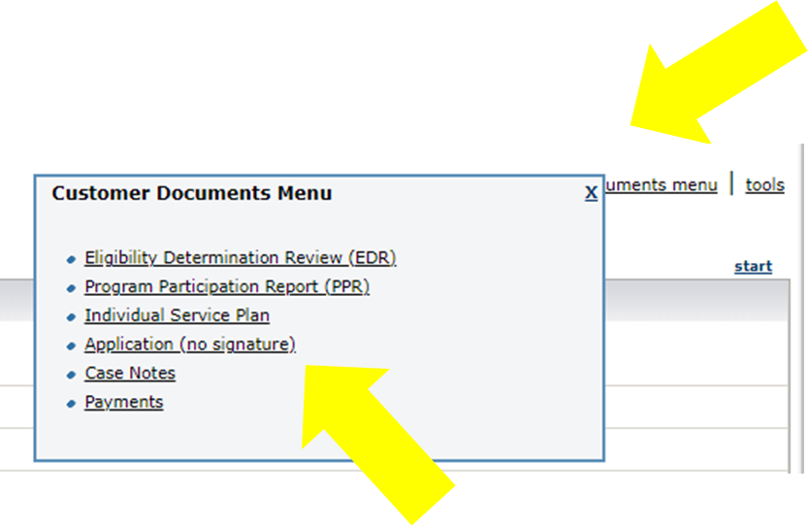
ITrac Data Entry for Staff Who Work at Rent Assistance Hub
EVALUATE REFERRAL
Review Registration Tab, Application and Career Plan, Prosperity Planner Budget.
Review Application via Customer Documents Menu or on Customer Documentation tab.
View Career Plan via Customer Documentation Tab.
File Exchange is an older tool that could be used.

Slide 7
ITrac Data Entry for Staff Who Work at Rent Assistance Hub
Review the Career Plan via green Customer Documentation Tab.
Locate the customer on the green Customer Documentation Tab.

Slide 8
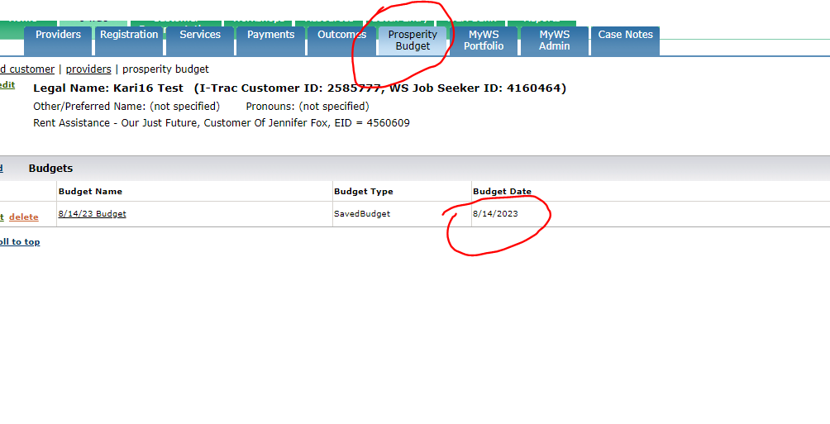
ITrac Data Entry for Staff Who Work at Rent Assistance Hub
Check Prosperity Budget Tab for the current (completed within the last 3 months) Prosperity Planner Budget

Slide 9
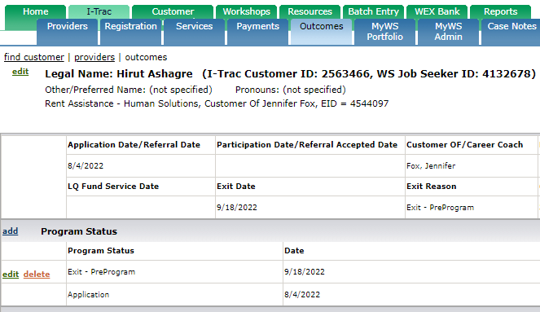
ITrac Data Entry for Staff Who Work at Rent Assistance Hub
ACCEPT OR REJECT REFERRAL
To accept, go to Registration Tab and locate Registration Completion Control.
Enter Review Date and Reviewed By at bottom.
To reject, go to Outcomes Tab and locate Program Status Control.
Enter “Exit Pre-Program” as Program Status.

Slide 10
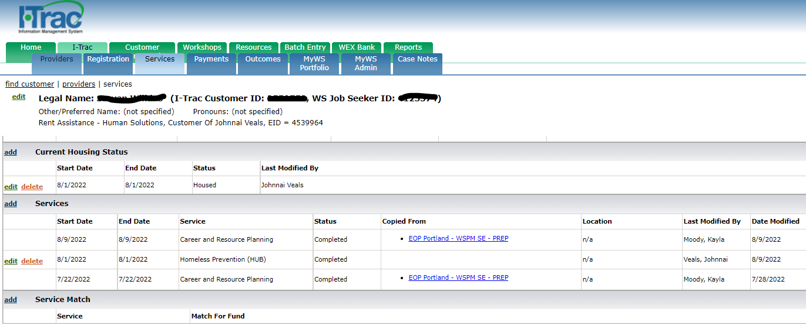
ITrac Data Entry for Staff Who Work at Rent Assistance Hub
ENTER FIRST HUB SERVICE
Rapid ReHousing
Customer currently experiencing homelessness or fleeing domestic violence.
Helps people obtain housing quickly
Provides short-term rental assistance and career coaching services
Homeless Prevention
Customer currently has a house or lives in an apartment.
Helps people stay housed
Provides short-term rental assistance and career coaching services

Slide 11
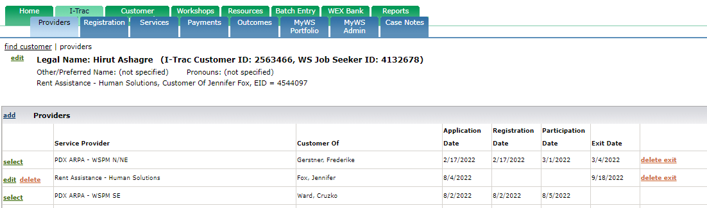
ITrac Data Entry for Staff Who Work at Rent Assistance Hub
ASSIGN HUB STAFF
Go to Providers Tab and Change Customer Of to Hub Staff Name.

Slide 12
ITrac Data Entry for Staff Who Work at Rent Assistance Hub
CONFIRM FIRST COACH SERVICE
Go to Services Tab.
Has coach copied first coach service?
Is service date correct?

Slide 13
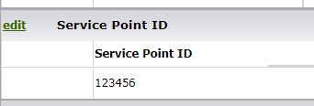
ITrac Data Entry for Staff Who Work at Rent Assistance Hub
INTAKE PARTICIPANT & COMMUNICATE WITH REFERRAL COACH
Follow Internal Hub Procedures to Intake Participant.
Enter participant into other data systems.
Enter Service Point ID on Payments Tab.
Communicate with referral coach as needed.
One way: go to Services Tab and update Housing Status.
Another way: Enter case notes on Case Notes Tab.

Slide 14
ITrac Data Entry for Staff Who Work at Rent Assistance Hub
CREATE AND ENTER PLAN
Go to Payments Tab and locate Rent Assistance Payment and Services Plan control.
Target End Date might change as participant is serviced
Enter Funding Source, Payment Types & Plan Notes
BEST PRACTICE: Use ONE Funding Source! If more than one Funding Source is used, create another plan entry.

Slide 15
ITrac Data Entry for Staff Who Work at Rent Assistance Hub
ASSIST PARTICIPANT & PAY RENT
Provide housing-related services in accordance with Regional Program Standards.
ESSENTIAL REQUIREMENT!
Referral coach must copy
at least one coach service
from home record
to Services Tab
each month.
Allowed Rent Assistance Payments
◆ Housing Related Costs  Motel Vouchers
◆ Move-In Fee  Security Deposit
◆ Rent  Rent Application Fee
◆ Rent Arrears  Property Debt
◆ Rent Late Fees
◆ Transportation  Utilities

Slide 16
ITrac Data Entry for Staff Who Work at Rent Assistance Hub
ENTER PAYMENT
Go to Services Tab and confirm referral coach has copied at least one coach service for the month that is previous to the month for which you are paying rent.
Go to Payments Tab and locate Rent Assistance Payments Control.
Enter one record for EACH payment the Hub makes.
Payment types are defined in the Regional Program Standards.

Slide 17
ITrac Data Entry for Staff Who Work at Rent Assistance Hub
EXIT PARTICIPANT
1) Go to Services Tab.
Enter last Housing Hub service “Hub Final Rent Exit” into Services Control. Use last day of last month rent paid. If exit before payment, enter current date.
2) Go to Payments Tab.
Add date to “End Date” field; select Completed as “Status” and enter “Housing Status at Funding End” on Rent Assistance Payment and Services Plan Control.

Slide 18
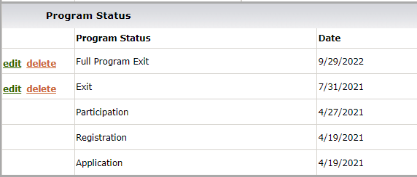
ITrac Data Entry for Staff Who Work at Rent Assistance Hub
EXIT PARTICIPANT
3) Go to Outcomes Tab.
Click Add and select Exit in Program Status Control
4) Go to Outcomes Tab.
Enter ‘At Exit’ as Type and choose ‘Housing Status’ in Rent Assistance Outcomes Control

Slide 19
ITrac Data Entry for Staff Who Work at Rent Assistance Hub
CONNECT WITH PARTICIPANT AT 6 & 12 MONTHS*
Six months after last rent payment, connect with participant to determine participant’s housing status.
Then, go to Outcomes Tab and locate Rent Assistance Outcomes Control.
Repeat 12 months after last rent payment.
*At Our Just Future, the Rent Assistance Coordinator does this connection and data entry.

Slide 20
ITrac Data Entry for Staff Who Work at Rent Assistance Hub
REPEATING RENT ASSISTANCE
Lifetime maximum of two rounds.
If 90+ days since original exit, create new RA record.
Go to Outcomes Tab in old record and locate Rent Assistance Outcomes Control.
Edit current Exit entry.
Select ‘At Exit’ as Type
Change Housing Status to ‘Received RA Again’
Notes are helpful, but optional

Slide 21
ITrac Data Entry for Staff Who Work at Hub
TIMELINE
Day 1 Coach Refers
Day 5 Hub Responds
Day 6 Coach Copies Service
Day 7 Hub Intakes
Create RA Record
Do Registration Tab
Sign & Save Application
Upload Career Plan
Save Prosperity Planner Budget
Email Hub
Evaluate Referral
Pre-Program Exit or Enter First Hub Service
Assign Hub Staff
Inform Referral Coach
Confirm First Coach Service
Intake
Update Housing Status
Future Days Hub Serves
Monthly Hub Pays
When Done Hub Exits
At 6 & 12 Months
Create & enter plan
Provide housing-related services
Confirm coach service copied
Pay Rent
Enter Payment
Enter exit
Enter ‘At Exit’ Outcome
Connect with participant
Obtain update
Enter housing status

Slide 22
Rent Assistance Hubs
WHO REFERS WHERE
AGENCY & PROGRAM | WORKSYSTEMS MANAGER | RENT ASSISTANCE
Central City Concern AHFE, EOP DCJ & EOP PDX | Lori Bean | Central City Concern
IRCO AHFE, EOP PDX | Stephen Blackford, Kari Brenk | Latino Network
Latino Network AHFE | Ernesta Ingeleviciute | Latino Network
Oregon Tradeswomen & Constructing Hope EOP ISVT | Tim Finnegan | Latino Network
Our Just Future AHFE, DCJ, EOP PDX | Ernesta Ingeleviciute | Our Just Future
POIC AHFE | Jennifer Fox | Our Just Future
SE Works EOP DCJ & EOP PICP and Reentry | Stephen Blackford, Ernesta Ingeleviciute | Latino Network

Slide 23
ITrac Data Entry for Staff Who Work at Hub
RESOURCES
RESOURCES
Visit Worksystems Knowledge Base!
ITrac Rent Assistance Data Entry Guide
Regional Program Standards for Rent Assistance Hub
Coach Handout – Top Two Tips for Rent Assistance Referrals
HOUSING HUB CONTACTS
Latino Network Hub
Worksystems Contract Manager – Ernesta Ingeleviciute (eingeleviciute@worksystems.org)
Latino Network RA Program Manager- Shian Gutierrez Ege (shian@latnet.org)
Latino Network Coordinator – Angelica Delima (angelica@latnet.org)
Our Just Future Hub
Worksystems Contract Manager - Jennifer Fox (jfox@worksystems.org, 503-936-7050)
Our Just Future RA Program Manager- Sonja Arigbon (sarigbon@ourjustfuture.org)
Our Just Future Coordinator – Renauda Mitchell (rmitchell@ourjustfuture.org)

