Slide 1
WIOA Title I Adult/DW
PY23 Updates

Slide 2
Background
In June 2020, the US Department of Labor released TEGL 23-19, where new data validation requirements were outlined for enrollment into WIOA Title-1 services. As a result of the new requirements, all nine Local Workforce Development Boards in Oregon collaborated to review and explore solutions to address the new requirements.
As a result of this review, in 2021, the Oregon Workforce Partnership approved changes to modify registration processes to be in compliance with WIOA Title-1 and implement follow-up services.
Training Agenda
Overview of Changes
WIOA Adult Eligibility
WIOA DW Eligibility & Dislocation Types
WIOA Adult Priority Populations
Documentation & Registration
New Data Collection
Follow-up & Planned Exit
Transition
Subtitle

Slide 3
Overview
3

Slide 4
WSO Customer Registration
WSO Customer Registration system will no longer determine WIOA program eligibility and will only be required to establish a Job Seeker ID. Some questions in WSO Customer Registration are also changing.
Eligibility Responsibility
Since WSO Customer Registration system is no longer determining WIOA program eligibility Worksystems and their subcontractors are now responsible for Adult and DW eligibility determination.
Legal to Work
WIOA eligibility will no longer require a participant be legal to work to receive program services. It will be important to review this status to meet the employment placement performance.
What’s Changed
4

Slide 5
Other Pre-Enrollment Steps
iMatchSkills will not be required to enroll into WIOA. This may be needed before engaging with OED programs or some Worksystems programs like On-the-Job Training.
WOMIS DOB Validation and WOMIS Welcome Conversation will not be required to enroll.
WIOA Title I Adult/DW Manual Enrollment Decisions
The Economic Opportunity Program (EOP) only has WIOA Adult funds so can only enroll in WIOA Adult.
WorkSource Portland Metro (WSPM) has both WIOA Adult and DW funds so can enroll in both based on the customer’s eligibility and what fund is being used to pay for the customer’s services.
What’s Changed
5

Slide 6
Priority of Service – Basic Skills Deficient
Added the ability to track basic skills deficient status.
Other I-Trac Registration & Documentation Updates
There are some new data elements that need to be captured for registration and some documentation requirements have changed.
Disability Program Co-Enrollment
For individuals who self-identify they are a person with a disability, there are additional data collection elements related to enrollment into other publicly funded programs.
Follow-up & Planned Exit
WIOA Follow-up services are now required to be offered for participants placed into employment and available for other participants that may need limited assistance post-exit.
What’s Changed
6

Slide 7
WSO Customer Registration questions have changed.
Disability Types updated
US Citizen or Non-Citizen Legal to Work is not required to complete WSO Customer Registration.
Single Parent updated
Foster Care System question added
New specific Veteran program questions added.
Long-term Unemployment question is new.
Cultural Beliefs is new.
Dislocated Worker questions have been removed.
What’s Changed
7

Slide 8
I-Trac will now contain all the required reporting and documentation elements for enrollment in WIOA Adult. Due to this the WIOA Eligibility Documentation Checklist is no longer a required form but is now a guide to help with eligibility determination and enrollment.
The checklist can help guide the enrollment conversation with the customer to help identify eligibility elements and documentation that a customer may have to provide before starting an enrollment.
What’s Changed
8

Slide 9
Eligibility
9

Slide 10
WIOA Title I Eligibility
Adult
Age 18+
In compliance with Selective Service
Economic Opportunity Program providers only have WIOA Adult funds in their contract therefore they are only allowed to enroll customers in WIOA Adult.
Legal to work is no longer required
10

Slide 11
WIOA Title I Eligibility
Dislocated Worker
In compliance with Selective Service
Has a qualifying dislocation from employment
When a participant goes to a WorkSource Center to receive funding for a Training they may need to enroll them in DW at that point in time. This will entail Center staff asking additional questions of the participant and signing the I-Trac Application for the DW enrollment which is separate from the Adult enrollment.
Legal to work is no longer required
Age is not a factor. I-Trac has minimum age = 14
11

Slide 12
While EOP providers can’t enroll a customer in DW the Dislocated Worker types are still a required reporting element to the Department of Labor and are data points in the Adult record therefore EOP providers must understand the definitions.
Displaced Homemaker
Business Closed or had a Substantial Layoff
Military Spouse
Self-Employed and Business Closed
Separating Service Member
Terminated or Laid-off Worker
Qualifying Dislocation Types
12

Slide 13
1. Displaced Homemaker
One of the following are true:
The applicant has been providing unpaid services to their family in the home who has been dependent on the income of another family member but is no longer supported by that income and is unemployed or underemployed and is also experiencing difficulty in obtaining or upgrading employment.
OR the applicant has been providing unpaid services to their family in the home who is the dependent spouse of a member of the Armed Forces on active duty whose family income is reduced because of a deployment, activation, relocation, or service-connected disability or death and is unemployed or underemployed and is also experiencing difficulty in obtaining or upgrading employment.
13

Slide 14
1. Displaced Homemaker
Underemployed is defined as:
The person is employed less than full-time and is seeking full-time employment.
The person is employed in a position that does not match their skills and training.
The person is employed but their family annual income is lower than the higher level of the poverty line or 70 percent of the LLSIL.
The person is employed, but their current income is lower than their previous job’s income.
14

Slide 15
2. Business Closed or had a Substantial Layoff
Defined as any one of the following:
Business closed due to permanent closure
OR Business experienced a substantial layoff (defined as 10 or more people)
OR Business announcement of closure within 180 days
15

Slide 16
3. Military Spouse
Defined a one of the following:
Employment loss due to relocation.
OR Difficulty obtaining or upgrading employment as a military spouse.
16

Slide 17
4. Self-Employed and Business Closed
Defined as one of the following:
Closed due to general economic conditions.
OR Closed due to natural disaster.
17

Slide 18
5. Separating Service Member
Is separating from the military and entering civilian labor force.
18

Slide 19
6. Terminated or Laid-off Worker
One of the following is true when the customer has already been terminated or laid-off or has a notice to be terminated or laid off:
•Eligible for or exhausted UI and unlikely to return to their previous industry or occupation.
•OR was employed for at least 3 months but is not eligible for UI due to not enough earnings or having worked for an employer not covered by the State UI law and is unlikely to return to their previous industry or occupation.
See next slide for ‘unlikely to return to previous industry or occupation’ definition
19

Slide 20
6. Terminated or Laid-off Worker
*unlikely to return is defined as one of the following
Negative economic conditions on the industry or occupation (e.g., pandemic or natural disaster impacts).
Decline in the person’s occupation in the labor market.
Significant barriers to employment, such as criminal background, lack of high school diploma or GED, disability, homelessness, cultural or language barriers, older worker (55+) or deficient in basic skills.
Previous industry or occupation has been eliminated or the person has been unable to secure a position at the same income level as their previous position.
Exhausted their unemployment benefits and have been unable to find a job in their previous industry or occupation.
Seasonally employed and unlikely to return because of automation of the position or a significant change in normal seasonal employment patterns.
20

Slide 21
Enrollment & Services Flow in I-Trac
21

Slide 22
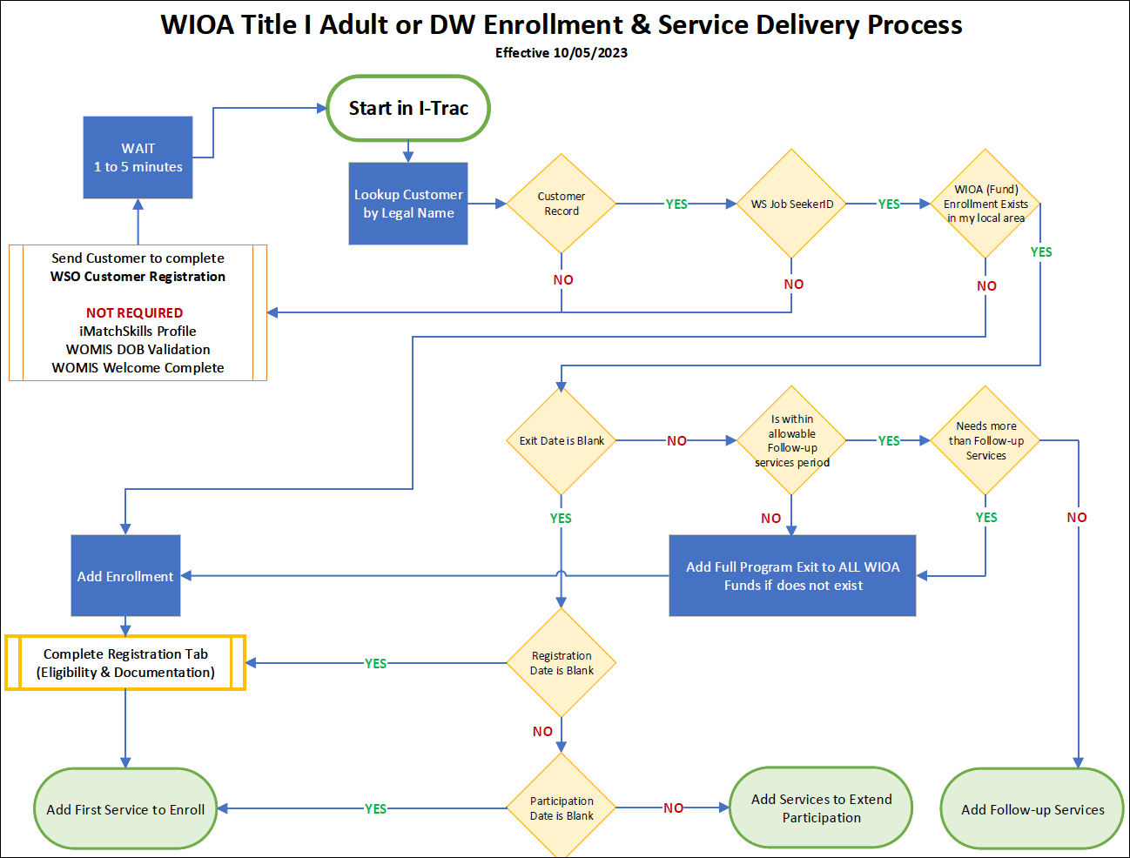
Enrollment & Services Flow
22

Slide 23
Providers Tab - ADD Enrollment(s)
Staff will manually ADD Adult enrollments. EOP providers are to use their own organization as the Adult provider and not a WorkSource Center provider.
Customers may be co-enrolled in Adult and DW. WSPM staff may enroll a participant in DW after a EOP provider has enrolled them in Adult.
If a customer comes to EOP from a WSPM referral they may be enrolled in DW. At that point, the EOP provider must then enroll them in Adult.
After the first WIOA record is added, if a second WIOA enrollment is added it will import details from the first record making data entry faster.
Where staff are enrolling a customer who is already enrolled in another local Workforce Board area, the data will import from that record. If that record is active, you are accepting that local area’s documentation and eligibility results.
Enrollment & Services Flow
23

Slide 24
New Registration Data Collection & Definitions
24

Slide 25
New Registration Data Collection & Definitions
Sex and Gender Identity
Wherever Sex (at birth) is collected, Gender (Identity) will also be collected. Self-identified.
Sex (Assigned at Birth) Male Female Not Disclosed | Gender (Identity) Man Woman Nonbinary or Genderqueer Not Disclosed
25

Slide 26
Social Security Number Consent to Disclose
Because I-Trac may have a participant’s SSN on record, it does not mean they have consented to our use of this number. For every new enrollment period:
Each participant must receive and have discussed with them the SSN Disclosure Statement
The SSN must be in I-Trac and staff will inform the customer’s consent to use.
Staff should know and understand how it is used and that it is encrypted once entered in the system.
The SSN is only shared through secure protocols with third parties for performance related crossmatching.
New Registration Data Collection & Definitions
26

Slide 27
Employment Statuses
We ask whether the customer is:
Employed
Not Employed
Has Received a Notice of Layoff or Termination
Not in the Labor Force
Work History
Funders would like to know if the participant has work history and if so, they want to know the following:
Most Recent Occupation (ONET)
Industry (NAICS) Q1 Before Application
Industry (NAICS) Q2 Before Application
Industry (NAICS) Q3 Before Application
New Registration Data Collection & Definitions
27

Slide 28
Unemployment Insurance Status
The following are new data points and documentation for some must be made in iMatchSkills.
Claimant (not referred by RESEA)- Signed Application.
Exhaustee- iMatchSkills
Exempt from job search requirements- Signed Application.
Not a Claimant or Exhaustee- iMatchSkills
New Registration Data Collection & Definitions
28

Slide 29
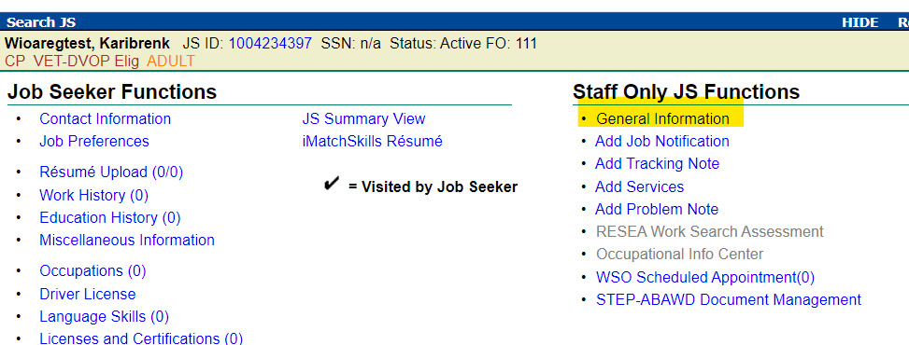
Unemployment Insurance Status iMatchSkills
New Registration Data Collection & Definitions
29

Slide 30
New Youth Related Characteristics
There are a few new youth specific data points, where customer’s age is under age 25.
Foster Care Youth (Aged Out)
Foster Care Youth (Current)
Free or Reduced Lunch Eligible (Youth)
New Registration Data Collection & Definitions
30

Slide 31
Six-Month Family Income
Income under WIOA is calculated based on family size while in EOP it is calculated based on household size. They are different definitions.
Family is defined as those living in the home and related by blood, marriage, or decree of court.
Household is defined as individuals who reside in the home and form one economic unit for purposes of tenancy or homeownership, regardless of whether they are legally related.
New Registration Data Collection & Definitions
31

Slide 32
WIOA Low Income
Six-Month Income Determination = Below Family Income Level
OR has at least one of the following characteristics:
One of these Public Assistance Characteristics
Received General Assistance in the last 6 months
Received Refugee Cash Assistance in the last 6 month
Received SNAP in the last 6 months
Received Supplemental Security Disability Income (SSDI) in the last 6 months
Received Supplemental Security Income (SSI) in the last 6 months
Received TANF in the last 6 months
OR Homeless (Includes Runaway Youth) characteristic exists
OR Foster Care Youth (Current) characteristic exists
OR Free or Reduced Lunch Eligible (Youth)
Note: Low income in EOP is different and is just 50% of the Median Family Income (MFI) for Portland Metropolitan Statistical Area for the participant’s household size.
New Registration Data Collection & Definitions
32

Slide 33
WIOA Adult Priority Populations
33

Slide 34
WIOA Adult Priority Populations
Department of Labor has established priority populations to provide services to certain populations.
Where two people are candidates for the same service and resources are limited, the priority will be given to the person from a priority population.
Priority Populations and related documentation can be updated in I-Trac after Registration if the participant’s circumstances change. Refer to the Regional Program Standards for guidance.
34

Slide 35
WIOA Adult Priority Populations
Level 1 Priority
Veteran (Not Dishonorable) or Veteran Eligible Spouse
AND Low Income or Basic Skills Deficient¹
Level 2 Priority
Low Income, Receiving Public Assistance, or Basic Skills Deficient¹
AND Non-Veteran or Veteran Eligible Spouse
Level 3 Priority
Veteran (Not Dishonorable) or Eligible Spouse
Level 4 Priority
Anyone enrolled
¹ Basic Skills Deficient is new data collection
35

Slide 36
WIOA Registration Documentation
36

Slide 37
WIOA Registration Documentation
Documentation is the act of proving a particular status.
The majority of the data collected at the time of registration is self-attested by the customer when signing the I-Trac application.
With the exception of Selective Service when an element cannot be documented at the time of registration, staff cannot choose yes to the element in I-Trac. If documentation is then obtained later this can be updated after registration and a Registration Note added to the record, so the customer does not need to re-sign the application.
Refer to the Regional Program Standards for required documentation elements. All required documentation for eligibility must be uploaded to I-Trac, including priority of service.
37

Slide 38
Documentation | Eligibility
Date of Birth
Public Assistance Benefits Letter
Public Assistance Crossmatch
School Record or ID Card
Selective Service Registration Acknowledgement Letter
Selective Service Registration Card
Signed Application ¹
Tribal ID Card
Baptismal Record
Birth Certificate
DD-214 Military Separation Record
Driver’s License
Family Bible
Government Issued Photo ID
Hospital Record of Birth
Justice System Record
Medical Record
Passport (US)
Passport (Foreign)
Applicant attestation documented with the signed application may only be used when the applicant does not have one of the allowable birthdate validation documents available. When applicant attestation is used for date of birth documentation, it is required that securing documentation necessary to complete employment (I-9) documentation be part of the service plan.
38

Slide 39
Documentation | Eligibility
Selective Service – Requirement to Register
Required Reasons | Status | Documentation Types by Status
I was sex-assigned male at birth AND I am a US Citizen OR immigrant residing in the US between the ages of 18 and 25 AND are age 18 or older AND were born on or after January 1, 1960 | Registered | Selective Service Registration Acknowledgement Letter Selective Service Registration Card Selective Service Stamped Post Office Receipt of Registration
 | Not Registered – I was unaware of the requirement to register and I am over the age of 25. | Request for Status Information Letter & Supporting Documentation Selective Service Status Information Letter
 | Not Registered – I willingly and lawfully chose not to register | Will not be eligible
 | Not Registered - I am between the ages of 18 and 25 and have not yet registered. | Must Register to be eligible.
39

Slide 40
Documentation | Eligibility
Selective Service – Not Required to Register/Exempt
Not Required/Exempt Reasons | Status | Documentation Types by Status
I was sex-assigned female at birth OR I was born before 1960 OR I am under the age of 18 OR I am a seasonal agricultural worker on a H-2A visa OR I am a lawful non-immigrant on a current non-immigrant visa OR I was incarcerated/hospitalized/institutionalized continuously between my 18th and 26th birthdays OR I was not living in the United States between my 18th and 26th birthdays OR I was on active US Military, Coast Guard duty or a student in an Officer Procurement Program continuously between my 18th and 26th birthdays | Not Required to Register | Signed Application (Age/Sex at Birth) Military Separation Record (DD-214) Immigrant/Non-Immigrant Allowable Documents Record of incarceration, hospitalization, or institutionalization
40

Slide 41
Documentation | Priority Population
Veteran & Eligible Spouse
Military Separation Record (DD-214)
Veteran Affairs Letter
Veterans Crossmatch (Department of Defense)
Veterans Crossmatch (Veterans Services System)
Signed Application¹
¹ Signed Application is not enough for WIOA Adult Prioritization of Services must obtain a document.
41

Slide 42
Documentation | Priority Population
Public Assistance
Public Assistance Types | Documentation by Public Assistance Type
Is exhausting TANF within 2 years Receiving SNAP Received Supplemental Security Disability Income (SSDI) in the last 6 months Received Supplemental Security Income (SSI) in the last 6 months Received TANF in the last 6 months | Public Assistance Benefits Letter Public Assistance Crossmatch Public Assistance Referral From Agency
Received General Assistance in the last 6 months Received Refugee Cash Assistance in the last 6 months | Public Assistance Benefits Letter Public Assistance Crossmatch Public Assistance Referral From Agency Public Assistance Check Copy Public Assistance Medical Card
Received SNAP in the last 6 months is collected for Low Income priority, but is not a type that sets the Public Assistance Priority Population.
42

Slide 43
Documentation | Priority Population
Basic Skills Deficient
Staff Attest to this element where a customer is basic skills deficient. By being logged into I-Trac and saving data, staff indicate and attest to their assessment.
Below are the allowable options to assess this:
Is enrolled in Adult Education or ESL classes
Limited English Skills- Assessment through staff engagement and observation
43

Slide 44
Documentation | Priority Population
Basic Skills Deficient
Staff Observation-Staff make observations of deficient functioning in completing forms, assisting in the development of a service strategy, or behaviors in group discussion settings.
GPA at D or below within the previous six months.
Qualifies for Special Education services or has an IEP Plan
44

Slide 45
Documentation | Other
Unemployment Insurance Status
Unemployment Insurance Statuses | Documentation by UI Status
Claimant Not Referred by RESEA Exhaustee | Signed Application
Exempt from job search requirements Not a claimant or Exhaustee | Crossmatch to MIS Database (iMatchSkills)
45

Slide 46
Documentation | Application
An Application has been added to the enrollment process for Adult and DW similar to what we already have in many of Worksystems Discretionary grants.
The signed Application is used for documentation for eligibility elements that can be self attested. Preference is to use the I-Trac eSignature tool to obtain the customer signature. If this tool is not possible to use the Application must be printed, signed and uploaded to I-Trac.
The signature statement now includes a Participation and Information Sharing Agreement. This agreement is used to collect the customer’s authorization to release their information with WIOA partners.
46

Slide 47
Documentation | Application
The signature statement is four pages. It is important for staff to view this statement before it is being given to customers to sign so they are familiar with the contents. Worksystems will send out a copy of this to review.
We translated the statement into five languages: Simplified Chinese, Traditional Chinese, Vietnamese, Russian and Spanish.
47

Slide 48
Disability Program Co-Enrollment
48

Slide 49
Where a customer self reports they are a person with a disability at registration, a new tab will appear in I-Trac. On this tab there are four new controls.
Programs
Financial Capability Services
Customized Employment Services
Work Setting
Disability Program Co-enrollment
49

Slide 50
Programs
The funder would like to know if the customer is engaged with one of the following three types of programs:
State Developmental Disabilities Agency (SSDA)
Oregon Health Authority
Community Health Programs
Behavioral Health Service
Local or State Mental Health Agency (LSMHA)
State Medicaid HCBS Waiver
If the customer works with one or more of these agencies, staff should get a release of information and coordinate program services. The services funded by the other programs are tracked in the next three controls.
Disability Program Co-enrollment
50

Slide 51
Disability Program Co-enrollment
Financial Capabiltiy Services
Did the customer receive these services? If yes, when?
Benefit planning services
Financial capability/asset development services
51

Slide 52
Customized Employment Services
Did the customer receive these services? If yes, when?
Discovery assessment services
Developed a customized employment search plan
Employer negotiation services
Secured employment after customized employment and support services
Disability Program Co-enrollment
52

Slide 53
Work Setting
Specify the work setting
Competitive Integrated Employment
Individual Supported Employment
Group Supported Employment
Sheltered workshop
Disability Program Co-enrollment
53

Slide 54
WSPM Referrals
54

Slide 55
We are working on a new business process for EOP participant referrals to WSPM for Center services.
EOP participants will not need to complete iMatchSkills, WOMIS DOB Validation or WOMIS Welcome Conversation to access Skills and Training Team staff and services in a WSPM Center however to access OED services they will.
Coordination between OED and WSPM staff is needed to make sure that EOP participants are not asked to complete steps to access WSPM services that are not required.
WSPM Referrals
55

Slide 56
Services
56

Slide 57
Services that Enroll
Career Coaching is the service used by EOP providers to enroll a customer. This service is the only service that is manually entered in the Adult record all other services must be copied from EOP.
Career Coaching and Job Search Assistance are the two services that must be copied to the WIOA Adult fund from the EOP fund. EOP funds will not keep Adult funds open unless services are copied to the Adult fund.
If support service payments are made with WIOA Adult funds these must be entered only in the WIOA Adult record and not the EOP record.
Services that Extend Participation (updates LQ Service Date)
Career Coaching and Job Search Assistance are copied to the Adult record and extend Participation.
Payments do not extend Participation.
Services
57

Slide 58
Services
A change has been made to the definition of training completer in line with Federal reporting requirements.
The new definition of Training Completer is when a participant has completed a planned program of training with a “complete” or “pass” designation from the school. The training end date is the last date the participant attended any service provided as part of that training program.
If a WSPM Center only pays for one term of a multi term program, they are not allowed to enter the training as a status of Completed until the entire program is completed regardless of how many terms the Center paid for.
Services
58

Slide 59
Planned Exit & Follow-up Services
59

Slide 60
EOP providers should try as best as possible to keep the Exit date in EOP the same as the Exit date in WIOA Adult.
Staff can manually enter a Planned Exit status in WIOA Adult- definition of this is on the next slide but this is not considered an actual Exit.
Exit is when the customer goes 90 days without a grant funded service.
Exit is system automated
Exit
60

Slide 61
NEW, but does not mean Exit.
It is a point in time before a customer is Auto-Exited when staff would like to begin to deliver follow-up program services only. This is a plan to Exit.
Staff manually add Planned Exit (Outcomes Tab, Program Status Control) as a trigger to lock in-program service controls and unlock follow-up program service controls.
It can be reversed before auto-exit, if the customer needs in-program services again. (Staff end, not delete, all follow-up services, and Grant Admin helps to delete the Planned Exit.)
An Exit status will auto populate 90 days after the Planned Exit date and the date will be the date of the last in program qualifying service.
What is a Planned Exit?
61

Slide 62
WIOA Follow-Up Services are provided upon a participant’s completion of their service strategy and are intended to help the participant be successful in employment.
WIOA Follow-up services must be offered to all participants upon the start of their employment. Follow-Up services must also be made available to any participant following Exit from the program unless the participant declines to receive them, or the participant cannot be located or contacted.
WIOA Follow-Up services are available for up to 12 months. Career Coaching and Job Search Assistance are the Follow-Up Services in WIOA Adult.
Training and support services are not allowed in Follow-Up with WIOA Adult funds.
Follow-up Services
62

Slide 63
The types of Follow-Up services provided, must be determined based on the needs of the participant; therefore, the type and intensity of services will differ for each participant.
EOP Follow-Up services are copied to the WIOA Adult fund.
Contacting a participant to secure performance-related data and information does not constitute Follow-Up services and should not be entered as a Follow-Up service in I-Trac.
If a customer needs more than the allowable follow-up services and the customer has already exited, then the customer may need to be re-enrolled.
Refer to the Regional Program Standards for the requirements and definition of Follow-Up.
Follow-up Services
63

Slide 64
Transition
64

Slide 65
Currently enrolled participants will carry into the new I-Trac record. If a participant is currently enrolled in DW I-Trac will auto populate an Adult record to continue the historic data that needs to be reported. Only enter services in the Adult fund.
If a customer has registered, but not yet enrolled, the customer will need to be Pre-Program Exited and enrolled in the new fund.
If WIOA Documentation has been completed the WSO Registration and Documentation Tab will be hidden.
If WIOA Documentation has not been completed staff will need to complete the Registration Tab to complete the WIOA Adult or DW enrollment.
Currently Enrolled
65

Slide 66
Title I Enrollment Flow Chart
Application Statements
Documentation Checklist Guide
WSPM Data Entry Guide
How to Create a Test Record in WOMIS
DHS STEP Registration in WOMIS
Attachments
66

Slide 67
Thank you!
Subtitle

