Slide 1
Worksystems CSS Stipend Payment System
What’s Covered in This Training
CSS or DPI?
Pay Cycle: Steps (slide 4) & Calendar (slide 5)
How Participants Set Up CSS Accounts (slides 6-13)
Pay Options for Participants (slides 14-21)
Participant Administration
Updating Participants (slide 23)
Entering Payments (slide 22)
Exiting Participants (slide 24)
Pay Card Administration
Pay Card Creation (slide 25)
Pay Card Status (slides 26 & 27)
Required Pay Card Reports (slides 28-34)
Helping Participants with Pay Cards (slide 35)
Contacts (slide 36)
Updated 12/8/2023
Notes:
Add How Staff Enter Milestones (managers only)? Last updated Sept 14, 2023

Slide 2
CSS or DPI? Decision Tree
Is your participant also doing a work experience program (WEX)?
Yes. My participant is also doing a WEX.
No. My participant
is not doing a WEX.
I don’t know
if my participant
is doing a WEX.
Use CSS.
Log onto the CSS Admin to enter stipend payments.
Use DPI.
Request the stipend when you approve WEX hours.

Slide 3
CSS Pay Cycle: Steps
P sets up CSS account
P chooses direct deposit or pay card
CC enters payments into CSS every other Monday
WS pays P every other Monday
CC supervisor approves payments every other Tuesday
CC de-enrolls P when learning ends
P = participant
CC = career coach
WS = Worksystems

Slide 4
CSS Pay Cycle: Calendar
PAY | PERIOD | DEADLINE TO ENTER PAYMENTS | DEADLINE TO APPROVE | PAY DATE
MONDAY | to SUND AY | MON @ 5 pm | TUE @ 5 pm | MON
8/5/2024 | 8/18/2024 | 8/19/2024 | 8/20/2024 | 8/26/2024
8/19/2024 | 9/1/2024 | 9/2/2024 | 9/3/2024 | 9/9/2024
9/2/2024 | 9/15/2024 | 9/16/2024 | 9/17/2024 | 9/23/2024
9/16/2024 | 9/29/2024 | 9/30/2024 | 10/1/2024 | 10/7/2024
9/30/2024 | 10/13/2024 | 10/14/2024 | 10/15/2024 | 10/21/2024
10/14/2024 | 10/27/2024 | 10/28/2024 | 10/29/2024 | 11/4/2024
10/28/2024 | 11/10/2024 | 11/11/2024 | 11/12/2024 | 11/18/2024
11/11/2024 | 11/24/2024 | 11/25/2024 | 11/26/2024 | 12/2/2024
11/25/2024 | 12/8/2024 | 12/9/2024 | 12/10/2024 | 12/16/2024
12/9/2024 | 12/22/2024 | 12/23/2024 | 12/24/2024 | 12/30/2024
12/23/2024 | 1/5/2025 | 1/6/2025 | 1/7/2025 | 1/13/2025
1/6/2025 | 1/19/2025 | 1/20/2025 | 1/21/2025 | 1/27/2025
1/20/2025 | 2/2/2025 | 2/3/2025 | 2/4/2025 | 2/10/2025
2/3/2025 | 2/16/2025 | 2/17/2025 | 2/18/2025 | 2/24/2025
2/17/2025 | 3/2/2025 | 3/3/2025 | 3/4/2025 | 3/10/2025
3/3/2025 | 3/16/2025 | 3/17/2025 | 3/18/2025 | 3/24/2025

Slide 5
How Participants Set Up CSS Accounts
Go to https://participant.stipendworksystems.org
Click on the red “Create Account” button
Notes:
BECCA: I think you can cover slides 4 to 9 with a live demo.

Slide 6
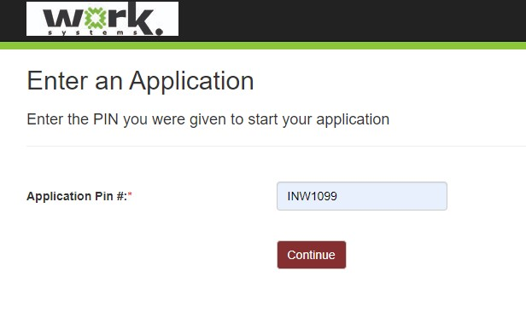
How Participants Set Up CSS Accounts: PIN
PROGRAM PIN CODES | Most Participants | Undocumented Participants
CareerWorks Medical | CWMSEW | n/a
Constructing Hope | CH1099 | CH599
Driving Diversity | DDSEW | n/a
Early Learning Works | ELW1099 | n/a
Gresham-Barlow SD | GBSD1099 | GBSD599
Info Tech @ IRCO | IRCOIT | n/a
Info Tech @ PCC | PCCWAIT | n/a
Info Tech @ POIC | POICIT | n/a
Learning Opportunities @ IRCO | IRCO1099LO | IRCO599LO
Learning Opportunities @ NAFY | NAFY1099LO | NAFY599LO
Learning Opportunities @ POIC | POIC1099LO | POIC599LO
NextUp | NXT1099 | NXT599
Nutrition Garden Rx | NGRX1099 | NGRX599
PPS Summer | PPS1099 | PPS599
Quick Start Semiconductor | QS1099 | n/a
Notes:
Mention Google spreadsheet with pay cycles and PIN codes. Put this link in chat: https://docs.google.com/spreadsheets/d/1wUWlBjZ9wl9Gb_fqXD0Rec5giqPiqW2fjaIPuCKXpDw/edit?usp=sharing

Slide 7
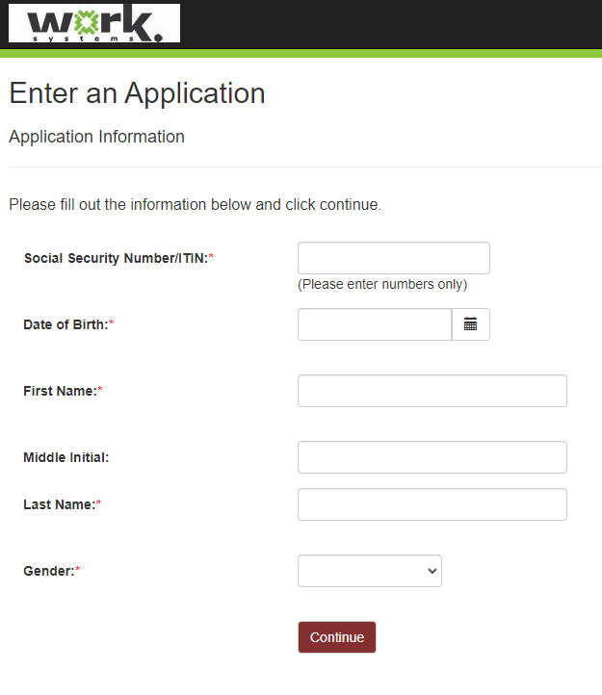
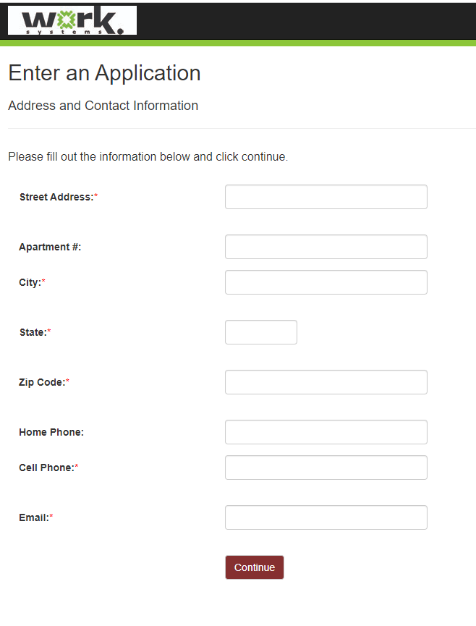
How Participants Set Up CSS Accounts: Contact Info

Slide 8
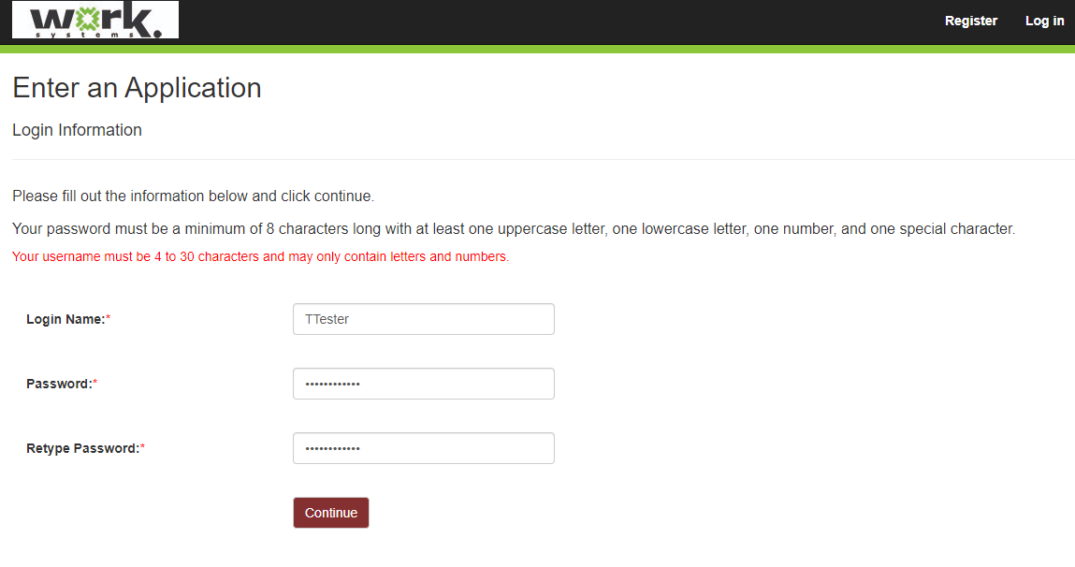
How Participants Set Up CSS Accounts: Login Info

Slide 9
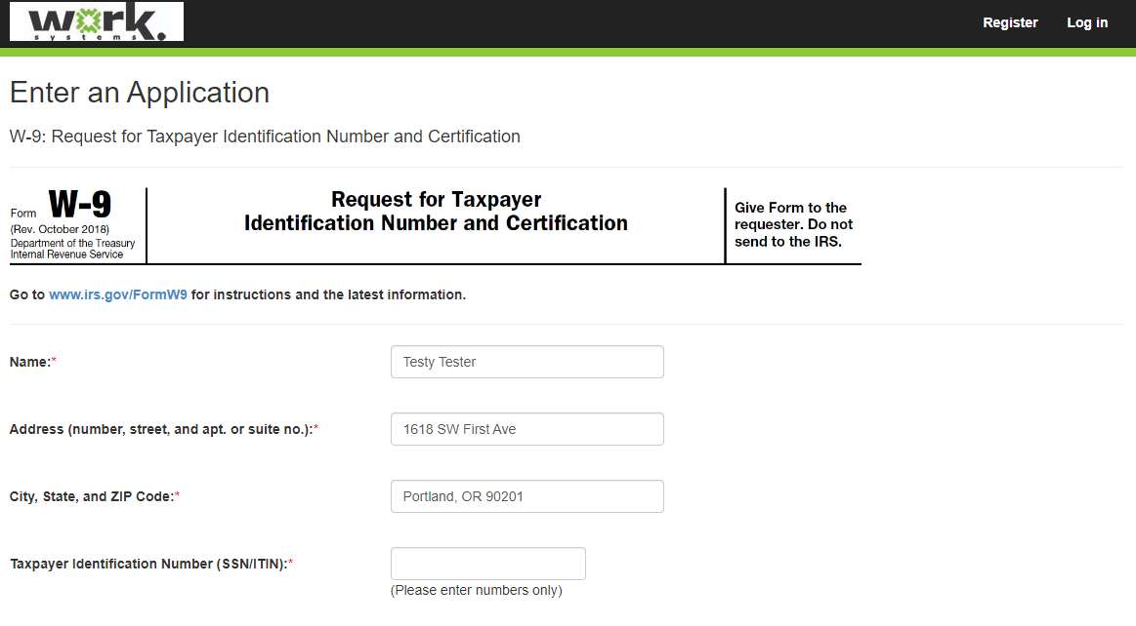
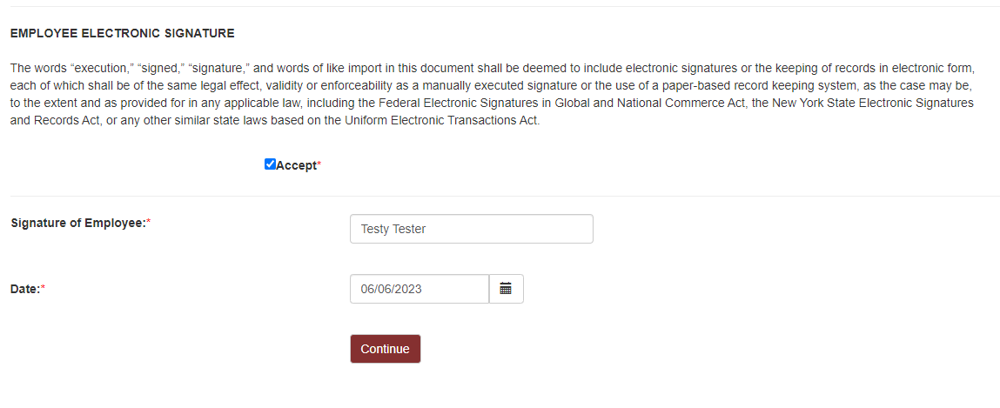
How Participants Set Up CSS Accounts: W9

Slide 10
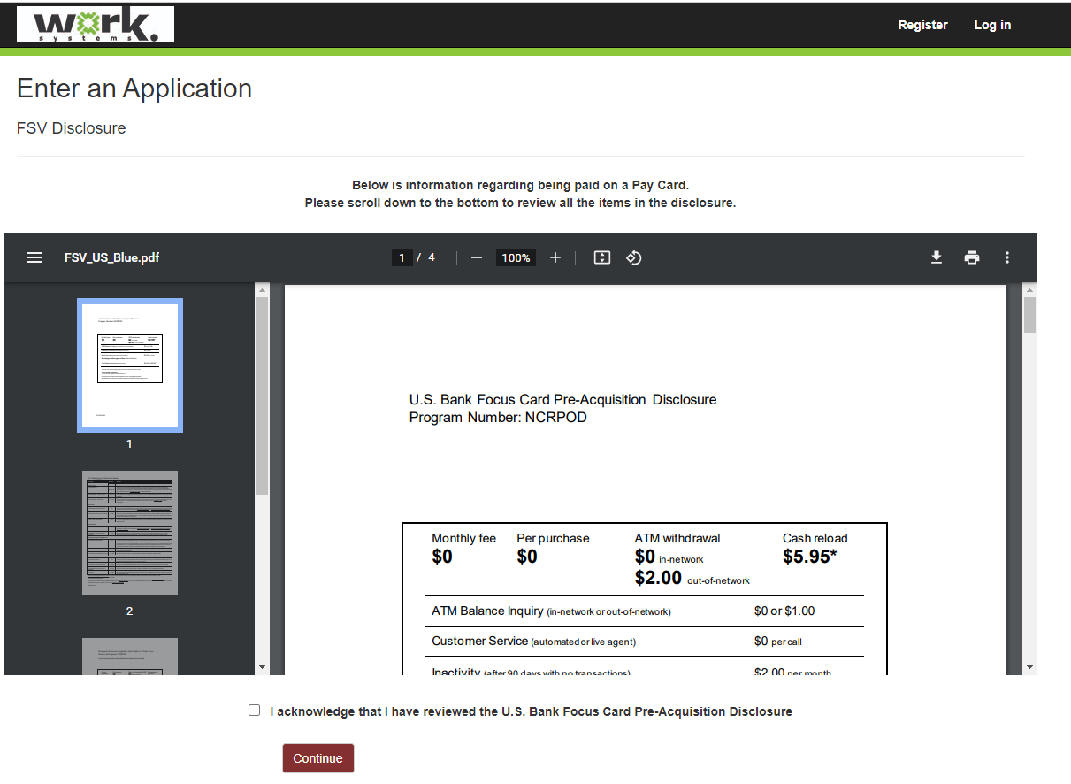
How Participants Set Up CSS Accounts: Pay Card Disclosure

Slide 11
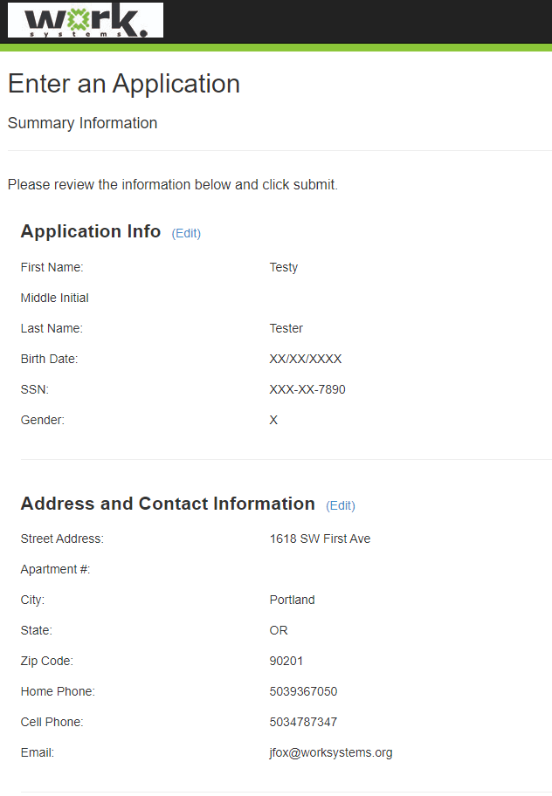
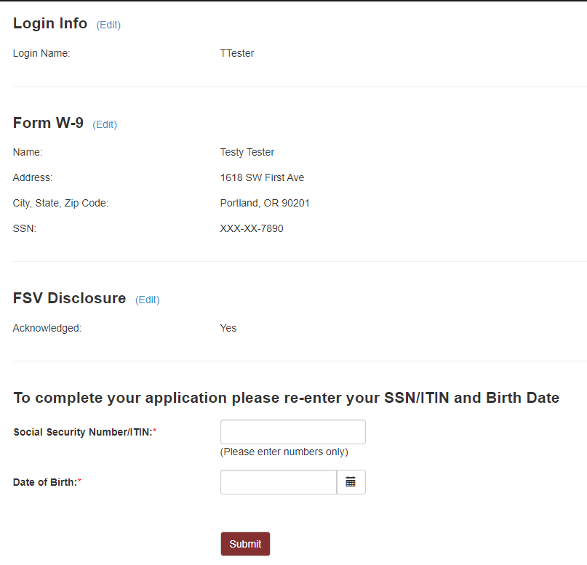
How Participants Set Up CSS Accounts: Review

Slide 12
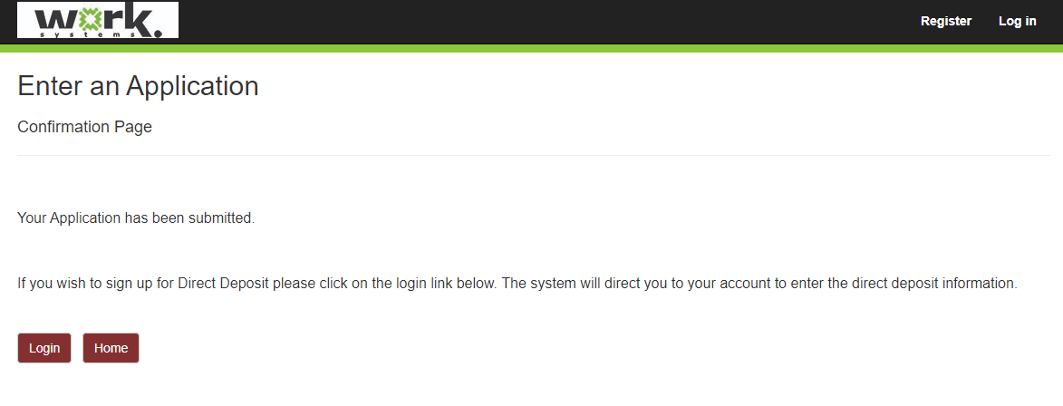
How Participants Set Up CSS Accounts: Pay Choice

Slide 13
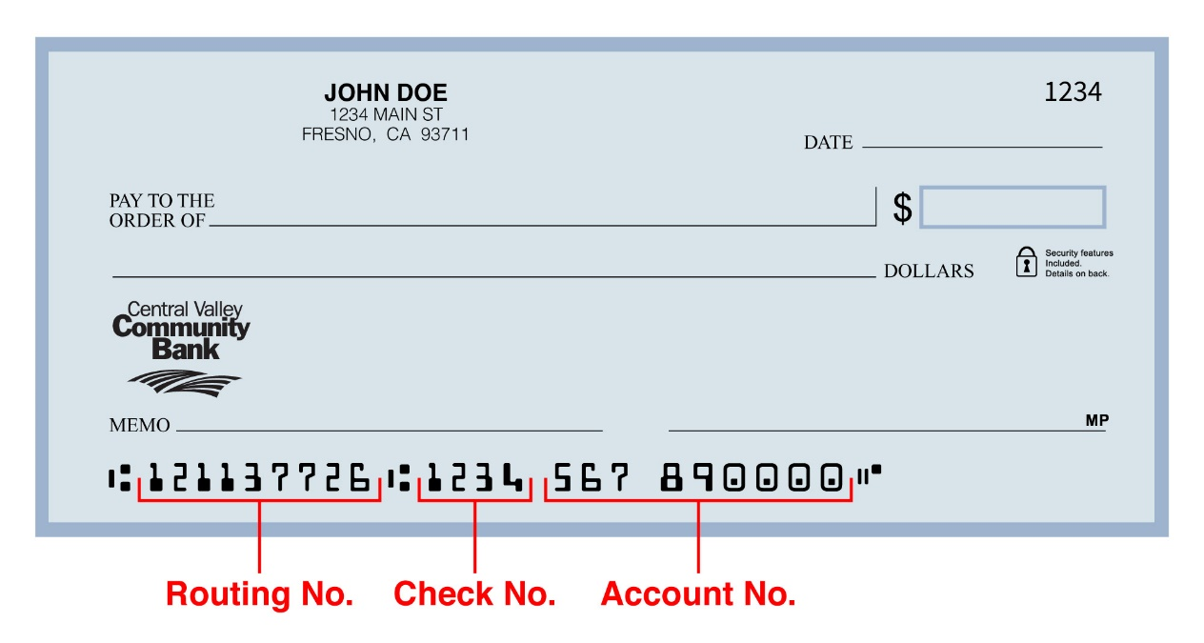
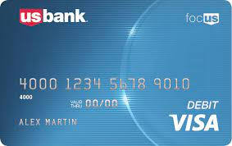
Pay Options for Participants
Direct Deposit
or
VISA Pay Card
4
Notes:
Discuss differences between direct deposit and VISA pay card.

Slide 14
Pay Options: Pay Cards
Pay cards are the default payment option. They are issued to all participants who do not successfully sign up for direct deposit.
4

Slide 15
Pay Options: Pay Cards - Activation
Participants Follow These Steps to Activate Pay Card
Open the envelope
Call the number on the card
Or, go to www.usbankfocus.com
Enter the 16-digit card number
Enter your 8-digit date of birth – month, day, year
Enter the last 4 digits of your SSN
Select a PIN (Easy for you, hard for someone else to guess!)
Ready to use!
4
Notes:
Show staff how to download handout participants receive in envelope with pay card.

Slide 16
Pay Options: Pay Cards - Transactions
Store Purchases
With or without cash back
Teller Withdrawal
Transfer to Bank Account
Savings Option
ATM Withdrawal
4

Slide 17
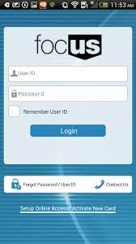
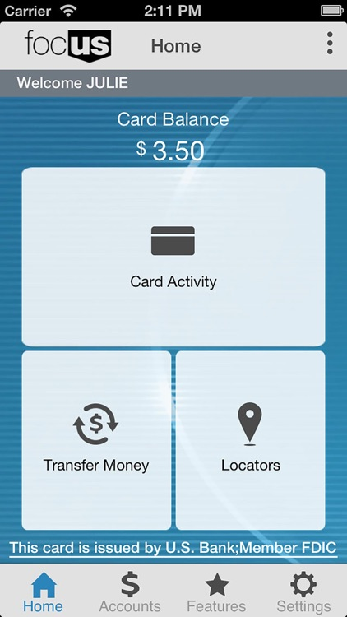
Use the App!
Pay Options: Pay Cards – Card App
Participants can:
check balances
track card activity
4

Slide 18
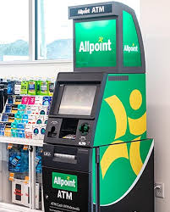
Pay Options: Pay Cards – ATM
Use US Bank or Allpoint ATM to take out $$ without fees!
4
Notes:
Participants can download and use the Allpoint ATM App.

Slide 19
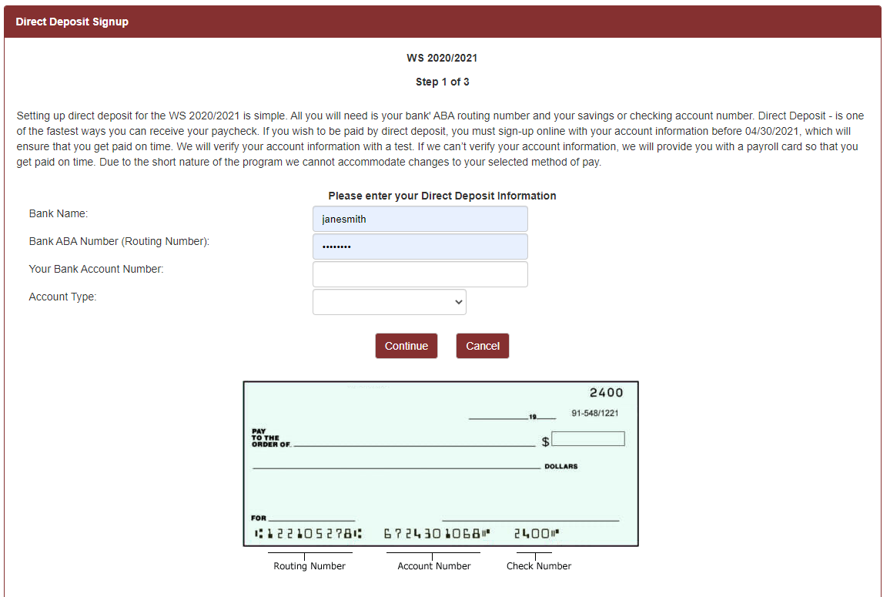
Pay Options: Direct Deposit – Set Up
Select Direct Deposit from menu.
Enter bank info.
Click continue.
Re-enter bank info on next screen.
Enter last 4 of SSN to confirm.
4
Notes:
BECCA: Please do a live demo for this slide on how to set up direct deposit.

Slide 20
Pay Options: Direct Deposit
CSS will test the participant’s bank account. CSS tests accounts (runs prenotes) weekly on Thursdays. Pay attention to the timing; review the next slide.
If the timing is too tight, CSS will issue the participant a pay card to use until direct deposit is activated.
If the test fails, CSS will issue the participant a pay card to use until direct deposit is corrected.
4

Slide 21
Pay Options: Direct Deposit Timing
PAY DAY A
Last day to enter new accounts / new direct deposit requests for PAY DAY B
THURSDAY AFTER PAY DAY
1. CSS prenotes direct deposit signups for PAY DAY B
2. CCC creates pay cards for PAY DAY B
Last day to enter payment requests
for PAY DAY B
Last day to approve payment entries for PAY DAY B
THURSDAY BEFORE PAY DAY
1. CSS creates pay cards for PAY DAY C
2. CSS processes payments for PAY DAY B
3. CSS prenotes direct deposit signups FOR PAY DAY C
PAY DAY B
4

Slide 22
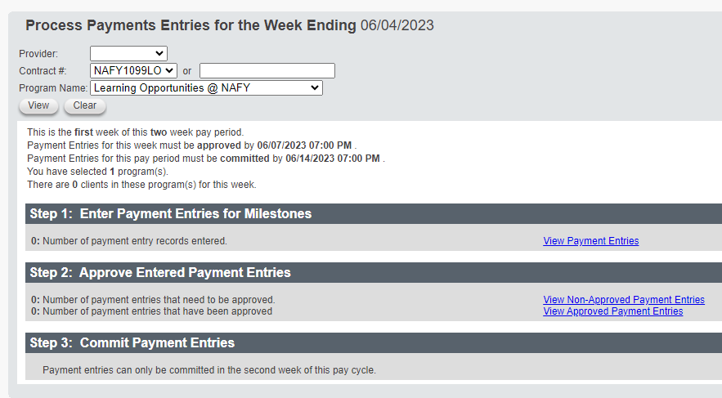
How Staff Enter Stipend Payments
Enter stipends EVERY OTHER MONDAY!
FIRST TIME ONLY: Update participant record with ITrac ID, coach name and fund code..
Select Dashboard from the Payment Entry menu.
Select your program name from drop down menu and click view.
Click “View Payment Entries” under Step 1.
Choose the entry method you like best.
To enter by milestone: Click on button for “Add Payment Entry by Milestone.”
Select milestone from dropdown menu.
A list of all participants doing that milestone will appear.
Enter number next to each participant you wish to pay.
Click save.
Switch weeks to enter hours for both weeks in the cycle by clicking the “switch weeks” button.
Ensure your supervisor approves your entered milestones by COB every other Tuesday.
Notes:
BECCA OR JEN: Offer live demo of how coaches enter stipend hours.

Slide 23
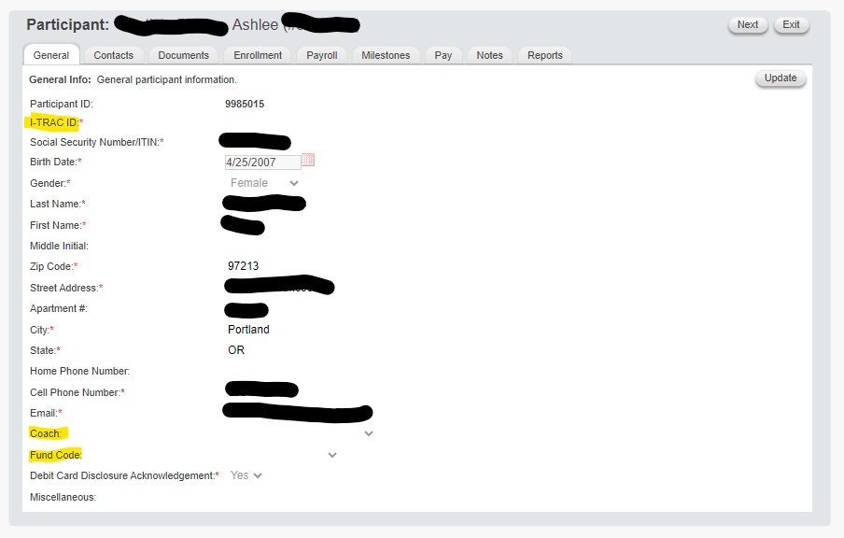
How Staff Update Participants
Update participant info the FIRST TIME you enter a stipend payment!
Select Participant Search from the Participants menu.
Click on the participant’s name to open their record.
You will see general participant info on the General tab.
Click the “Update” button on the right side of the screen.
Locate the “ITrac” field and enter the participant’s ITrac ID number.
Locate the “Coach” field and select your name.
Locate the “Fund Code” field and enter the fund code for the fund paying this stipend
Click the “Save” button on the right side of the screen.
TIP: You can use the “Next” button on the top right side of the screen to navigate to the next participant’s record. This is useful if you are updating more than one person’s info.
Notes:
BECCA OR JEN: Offer live demo.

Slide 24
How Staff Exit Participants
Exit participants when they finish their program!
Select Participant Search from the Participants menu.
Click on the participant’s name to open their record.
You will see general participant info on the General tab.
Click on the Enrollment tab.
Click on the blue Edit link next to the program that is finished.
Click the “Update” button on the right side of the screen.
Locate the “Ending Date” field and enter the last date of the program.
Locate the “Ending Reason” field and select the reason: Never Started, Quit, Successful Completion.
Click the “Save” button on the right side of the screen.
TIP: You can use the “Next” button on the top right side of the screen to navigate to the next participant’s record. This is useful if you are exiting more than one person.
Notes:
BECCA OR JEN: Offer live demo.

Slide 25
Pay Cards – Creation
A pay card is created for a participant when the participant has a CSS account.
The pay card company then mails the card to that participant’s coaching agency 1-2 days after its creation. Cards are shipped via UPS 2-day air. Coaches must deliver pay cards to their participants before the next pay day.
Coaches can check the “Debit Card Inventory Report” in CSS to see if a pay card has been created. The report is in the “Debit Card” section on the REPORTS tab.

Slide 26
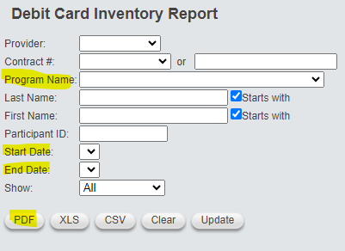
Pay Cards – How to Check Card Status
Click on Debit Card Inventory Report.
Complete yellow-highlighted fields.
Click PDF button.
4
Notes:
Offer live demo.

Slide 27
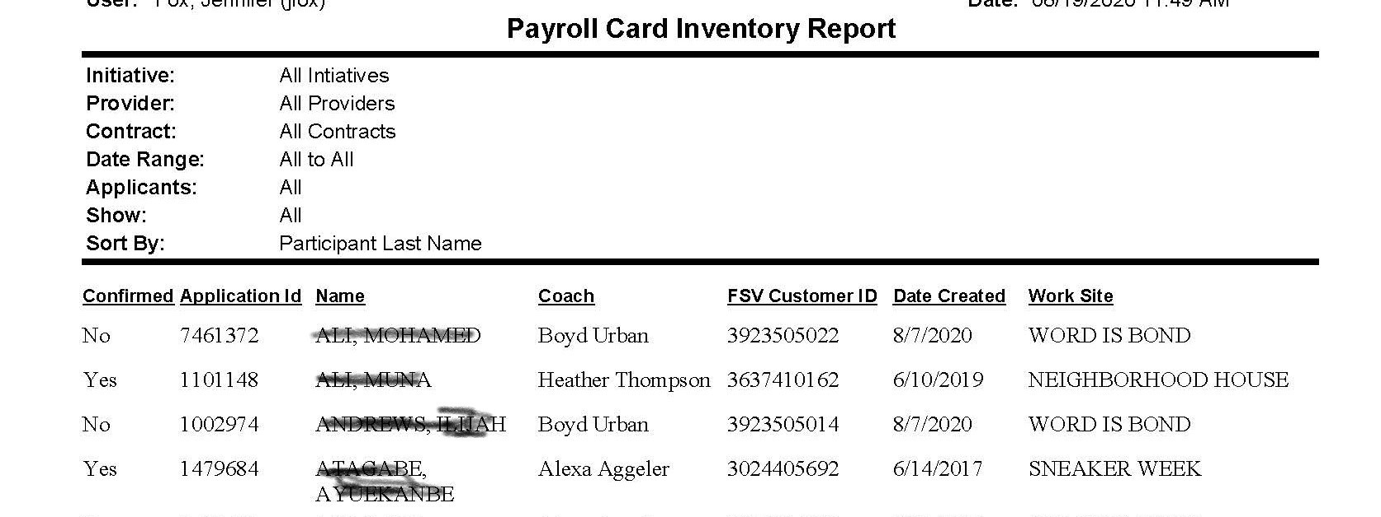
Pay Cards – How to Check Card Status
The resulting report lists youth name, coach, card ID #, date created and program name. If you have a question about when the cards will arrive, email Jennifer Fox.
4

Slide 28
Pay Cards – Required Reports
Coaches are required to complete two reports that help us track and inventory pay cards.
“Debit Card Inventory Report”
This report is updated to show you have received the pay cards at your agency. It must be updated within two days of card delivery.
“Debit Card Sign Off Report”
This report is updated to show you have delivered the pay cards to your participants. Participants must sign the report to acknowledge receipt. They must receive cards before, or on, the next pay day. The next pay day is the deadline to complete this report.
Notes:
Offer live demo

Slide 29
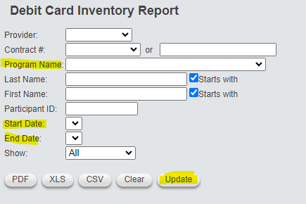
Pay Cards – Required Reports
Confirming Delivery
When cards are received, coaches must document receipt, again using the “Debit Card Inventory Report.” This report must be updated within two days of delivery.
Click on Debit Card Inventory Report.
Complete yellow-highlighted fields.
Click UPDATE button.

Slide 30
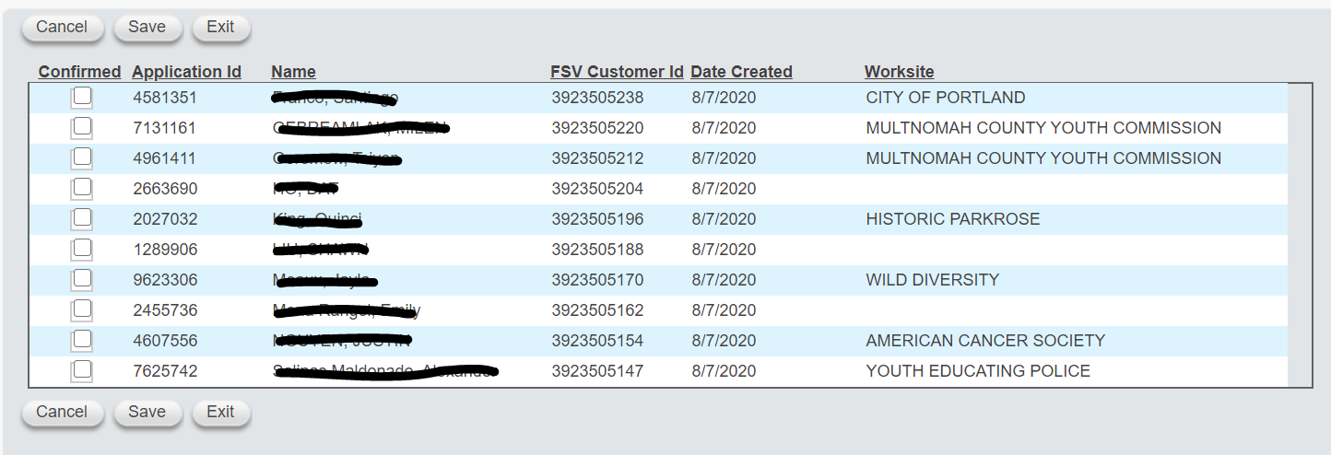
Pay Cards – Required Reports
Confirming Delivery
Click on box for each card received. Then, click SAVE.
4

Slide 31
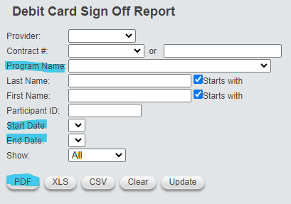
Pay Cards – Required Reports
How to Give Cards to Participants
Click on Debit Card Sign Off Report.
Complete blue-highlighted fields.
Click PDF button.
4

Slide 32
Pay Cards – Required Reports
How to Give Cards to Participants
Youth can sign and date the resulting report to acknowledge receipt.
4

Slide 33
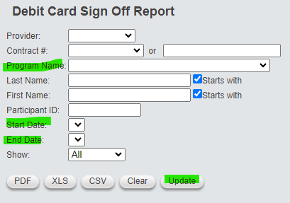
Pay Cards – Required Reports
Confirming Participants Have Cards
When cards are given to participants, coaches must document it, again using the “Debit Card Sign Off Report.” Participants must receive cards before, or on, the next pay day. You must complete this report before the next pay day.
Click on Debit Card Sign Off Report.
Complete green-highlighted fields.
Click UPDATE button.
4

Slide 34
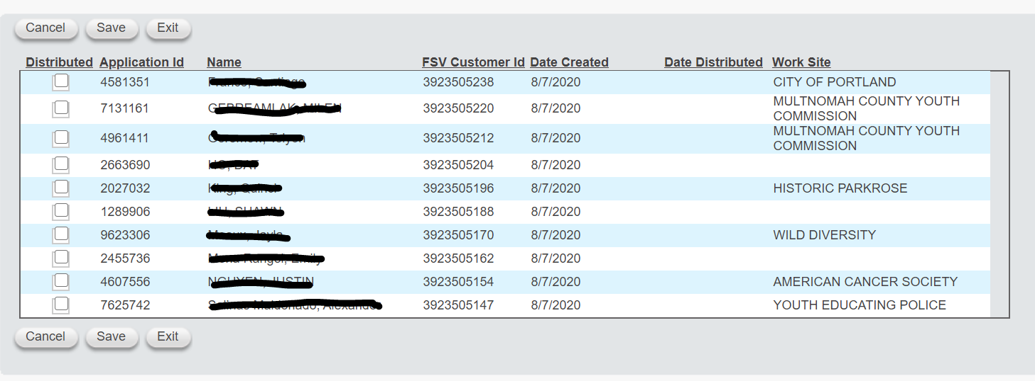
Pay Cards – Required Reports
Confirming Participants Have Cards
Click on box for each card given to that participant. Then, click SAVE.
4

Slide 35
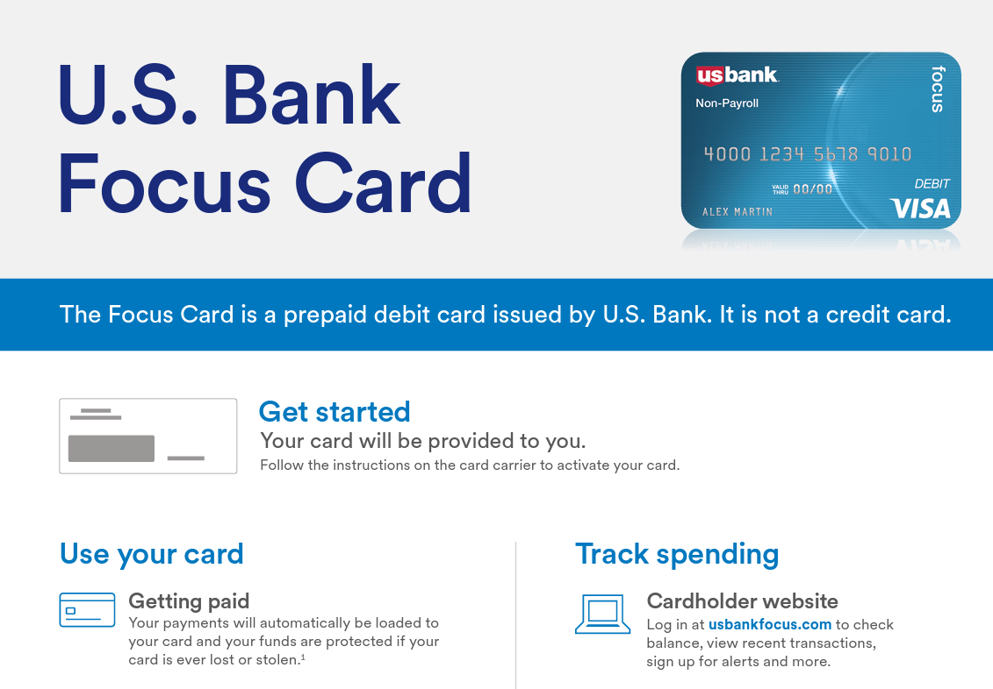
Pay Cards – Helping Participants
The Documents section in CSS has a quick reference guide that will help you understand pay cards. This same guide is inside the envelope that contains each participant’s card.
4

Slide 36
Worksystems Stipend Contacts
If you have questions, contact:
CSS Administrator: Jennifer Fox, 503-235-8266
Adult Stipends Project Manager: Jennifer Fox
Youth Learn & Earn Project Manager: Matthew Heady
Youth Learning Opportunities Project Manager: Lindsey Davis
4

Slide 37
CSS or FCCC or DPI? Key Differences
CARCAT | CSS
Coach enters participant info on spreadsheet. | Participant creates an account for payment site.
W9 is a Jot form. | W9 is part of account creation.
To request payment, coach submits ticket. | To request payment, coach enters milestone into payment admin site.
Every other Wednesday 10 days before Friday pay day | Every other Monday 7 days before Monday pay day
Pay card only | Pay card or direct deposit
Coach can submit ticket to request pay card info | Coach can look up pay card info on admin site.
Payments listed on Google sheet. | Coach can look up, or run reports on, payments, milestones and participant info.

