Slide 1

Forward Program Training
Facilitator: Chineva Smith, Education & Training Manager
Thursday, January 16, 2025

Slide 2

Agenda
Program Overview
Trauma Informed Care Financial Education
Program Materials
Module Overview
Module Activities
Wrap Up

Slide 3

Forward Program
FORWARD EMPOWERS ECONOMICALLY VULNERABLE ADULTS WITH FINANCIAL STRATEGIES.
Notes:
The Forward program empowers economically vulnerable adults and those in life transitions who face challenges like reliance on alternative financial products, irregular income, limited savings, difficulty managing expenses, debt issues, and various life circumstances.
The goal is to coach participants in a way that they are equipped with the tools they need to navigate their financial journeys successfully.
The sessions are offered as a progressive series. Each session is interactive and focuses on behavioral skills to help participants build their desired lives. Each session lasts 2 hours with a short break at the midpoint.
One facilitator teaching all four sessions fosters strong relationships to ensure completion, provides continuity in instruction, offers personalized support, and enhances accountability.

Slide 4
Trauma Informed Care Financial Education
Notes:
The Forward Program integrates trauma-informed care (TIC) principles to create a supportive and inclusive environment that empowers participants to
navigate financial challenges. Recognizing the pervasive impact of trauma, the program incorporates strategies that prioritize safety, transparency, and
cultural sensitivity, fostering trust and empowerment.
By addressing the intersection of financial well-being and personal experiences, it equips participants with tools to achieve sustainable financial stability
while respecting their unique needs and histories.

Slide 5
How Trauma-Informed Care Supports Financial Education
Safety & Trust
Cultural and Individual Sensitivity
Empowerment Focus
Acknowledgment of Trauma’s Impact
Inclusive Environment

Slide 6

How to Utilize Trauma-Informed Care while Coaching
Establish Clear Boundaries and Expectations
Foster Emotional Safety
Promote Empowerment and Choice
Incorporate Cultural Competence
Use Collaborative and Strength-Based Approaches

Slide 7
Forward Program Materials

Slide 8


Forward: PowerPoint Slide Decks
Notes:
We’ve designed PowerPoint slide decks to seamlessly guide you through each of the four Forward modules.
Each module is paired with a customized slide deck that includes a sample script, references to learner workbook activities, and clear transition points to support you as a facilitator.
These resources are crafted to enhance your delivery, ensure smooth navigation through the content, and create an engaging experience for participants.

Slide 9
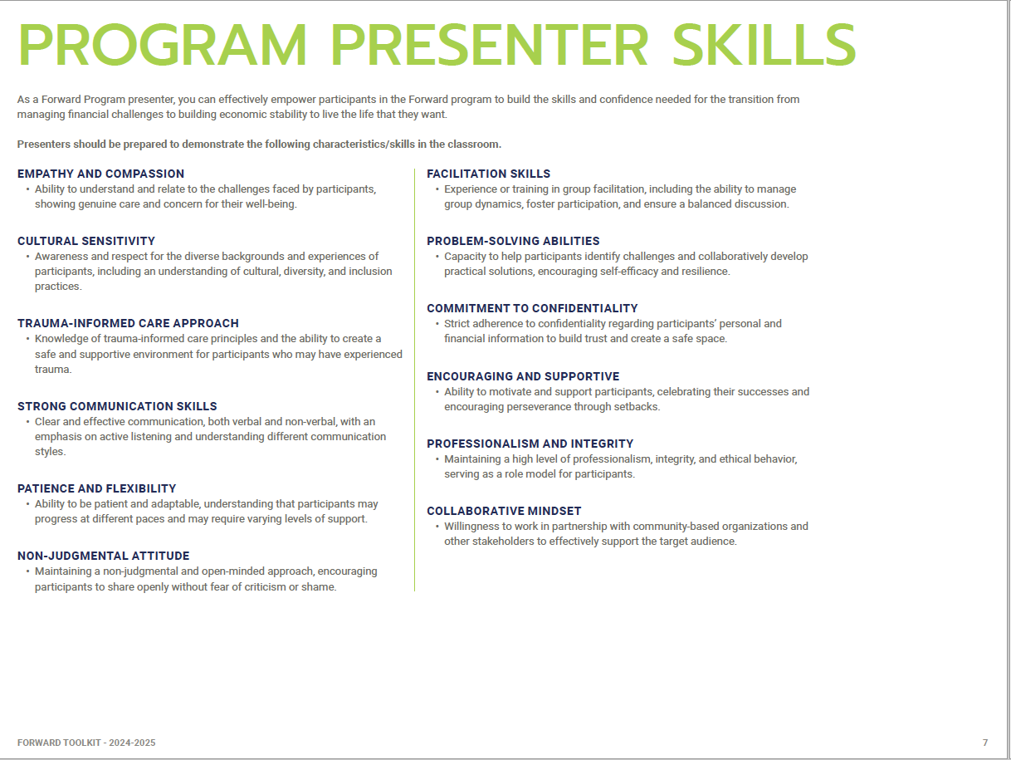
Forward: Toolkit

Slide 10
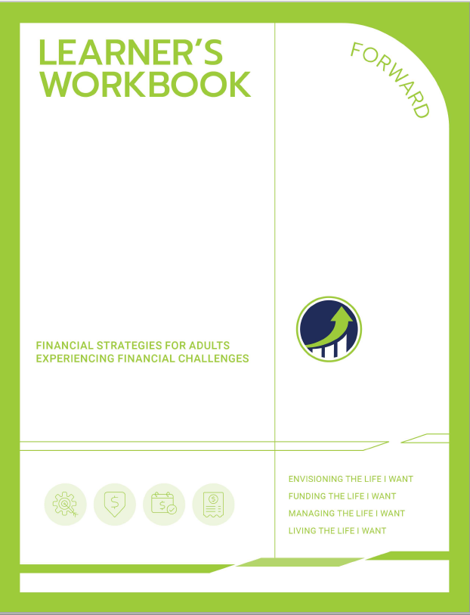
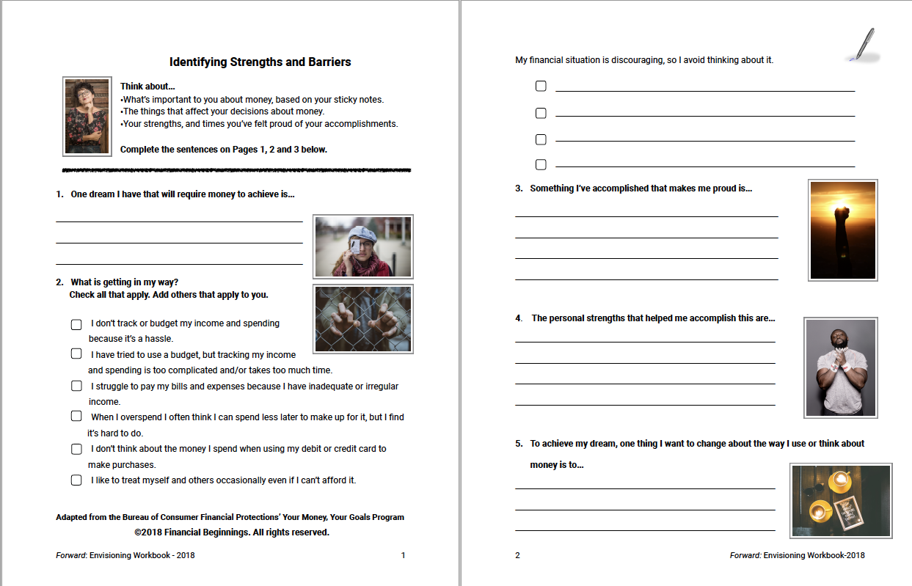
Learner’s Workbook

Slide 11
Forward Module Overview

Slide 12
Adult
Forward empowers economically vulnerable adults with financial strategies.
MODULES
Envisioning the Life I Want
Funding the Life I Want
Managing the Life I Want
Living the Life I Want

Slide 13
Forward Module Activities

Slide 14
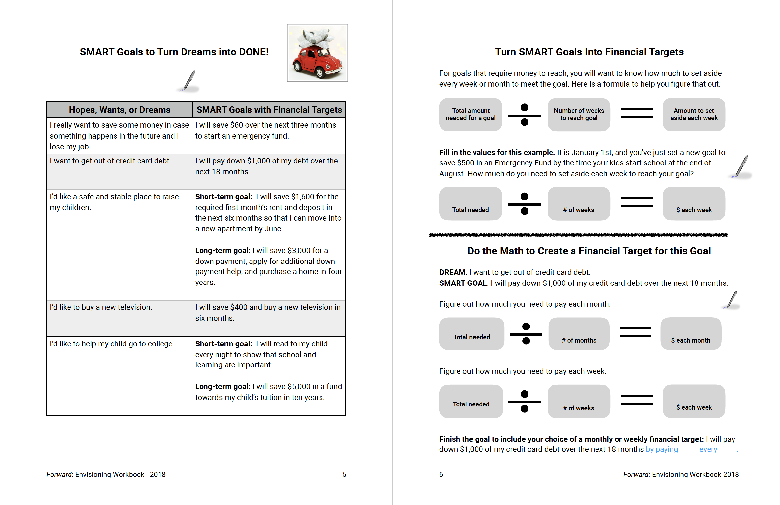
Envisioning the Life I Want

Slide 15
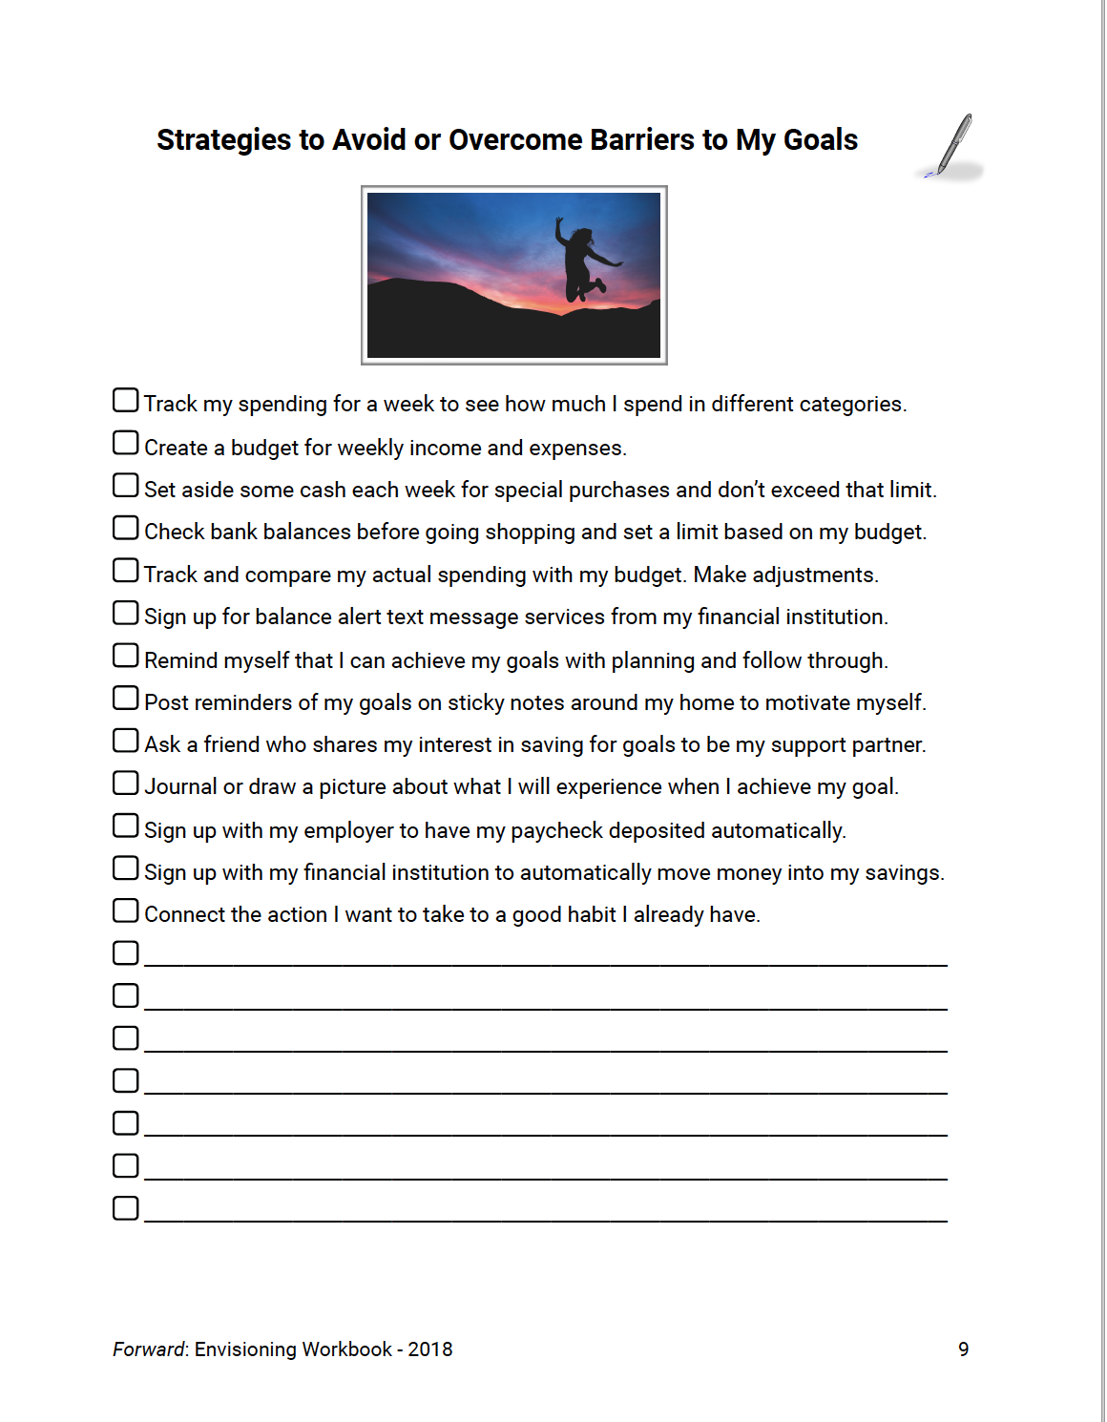
Envisioning the Life I Want

Slide 16
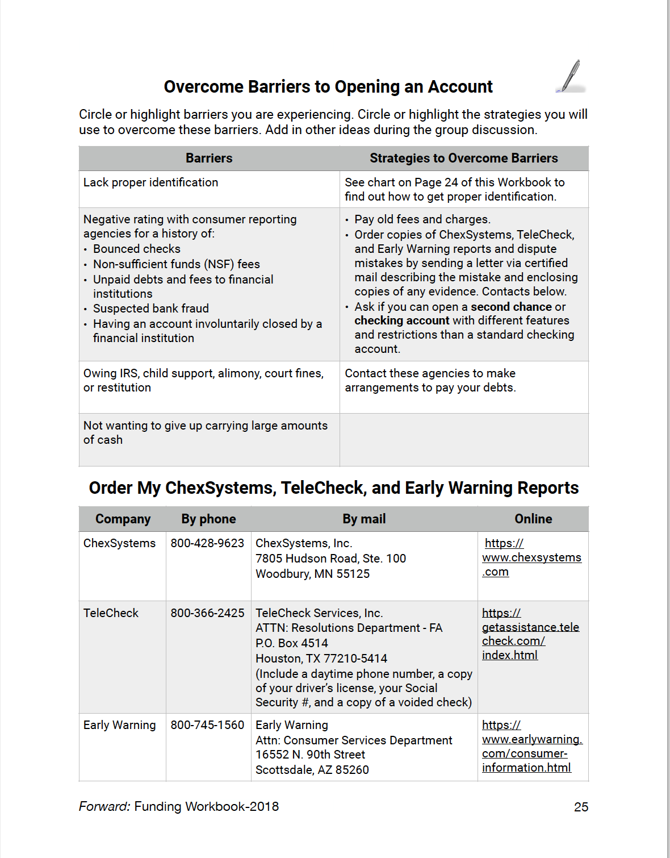
Funding the Life I Want

Slide 17
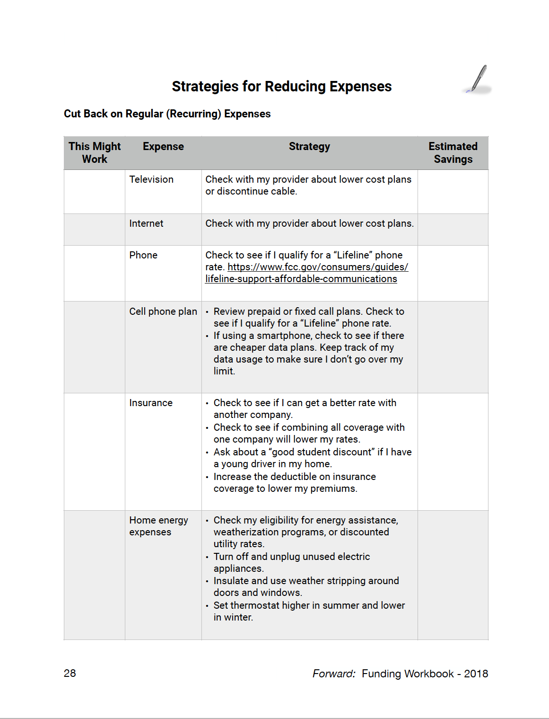
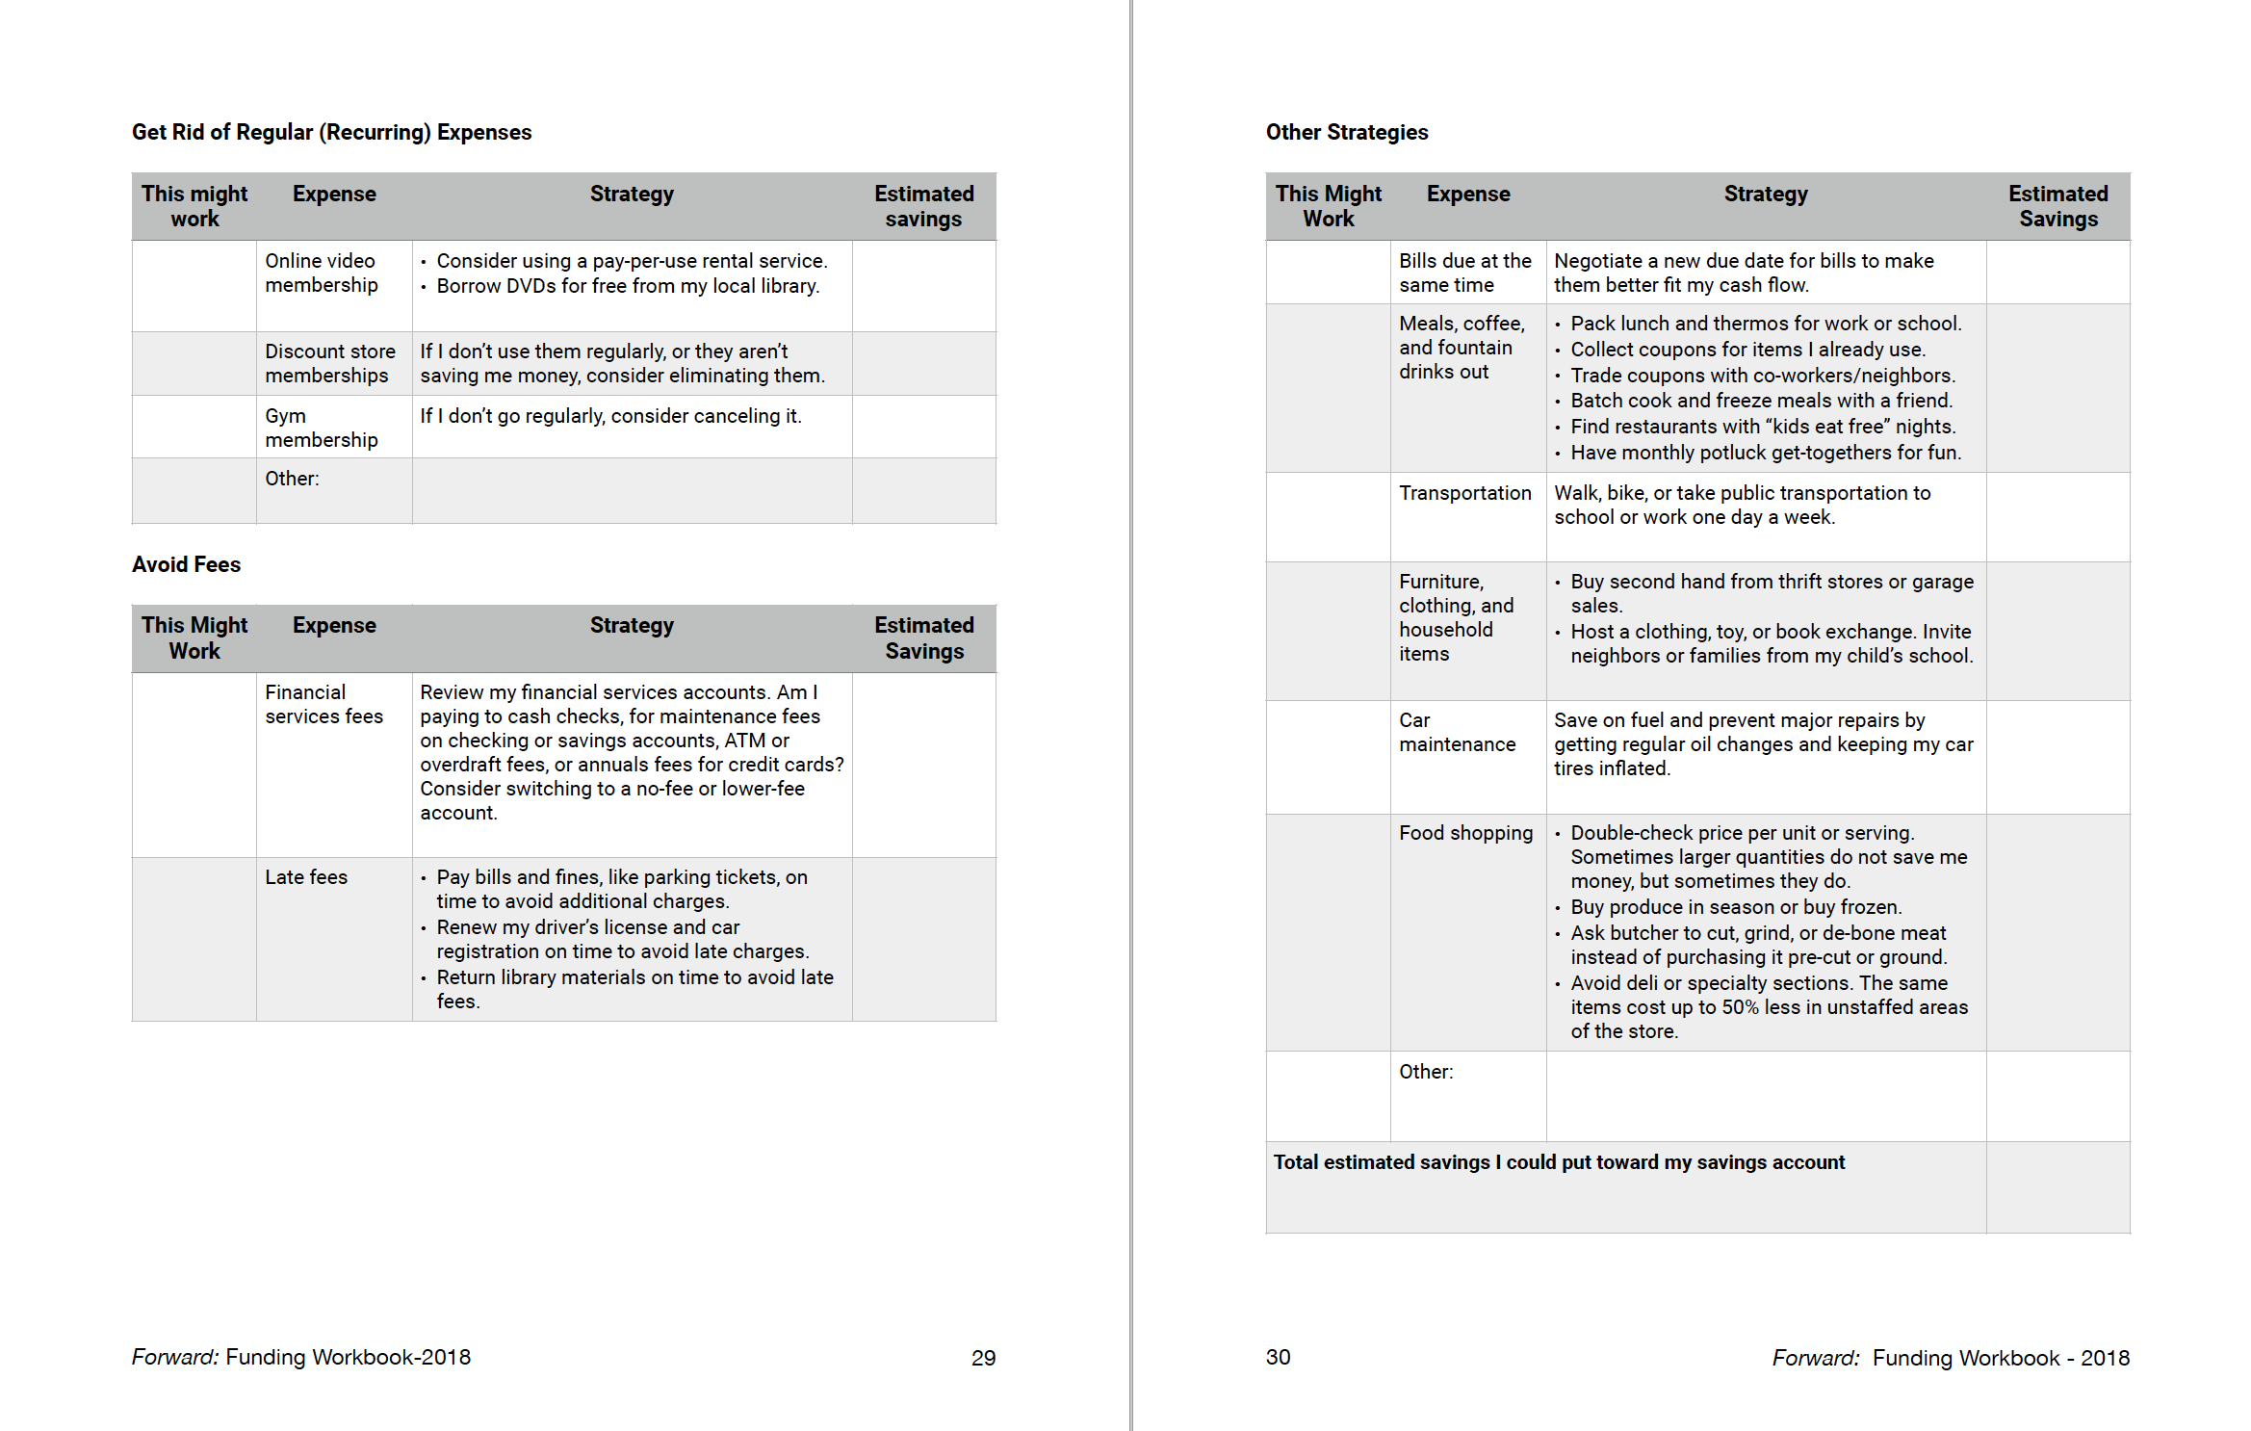
Funding the Life I Want

Slide 18
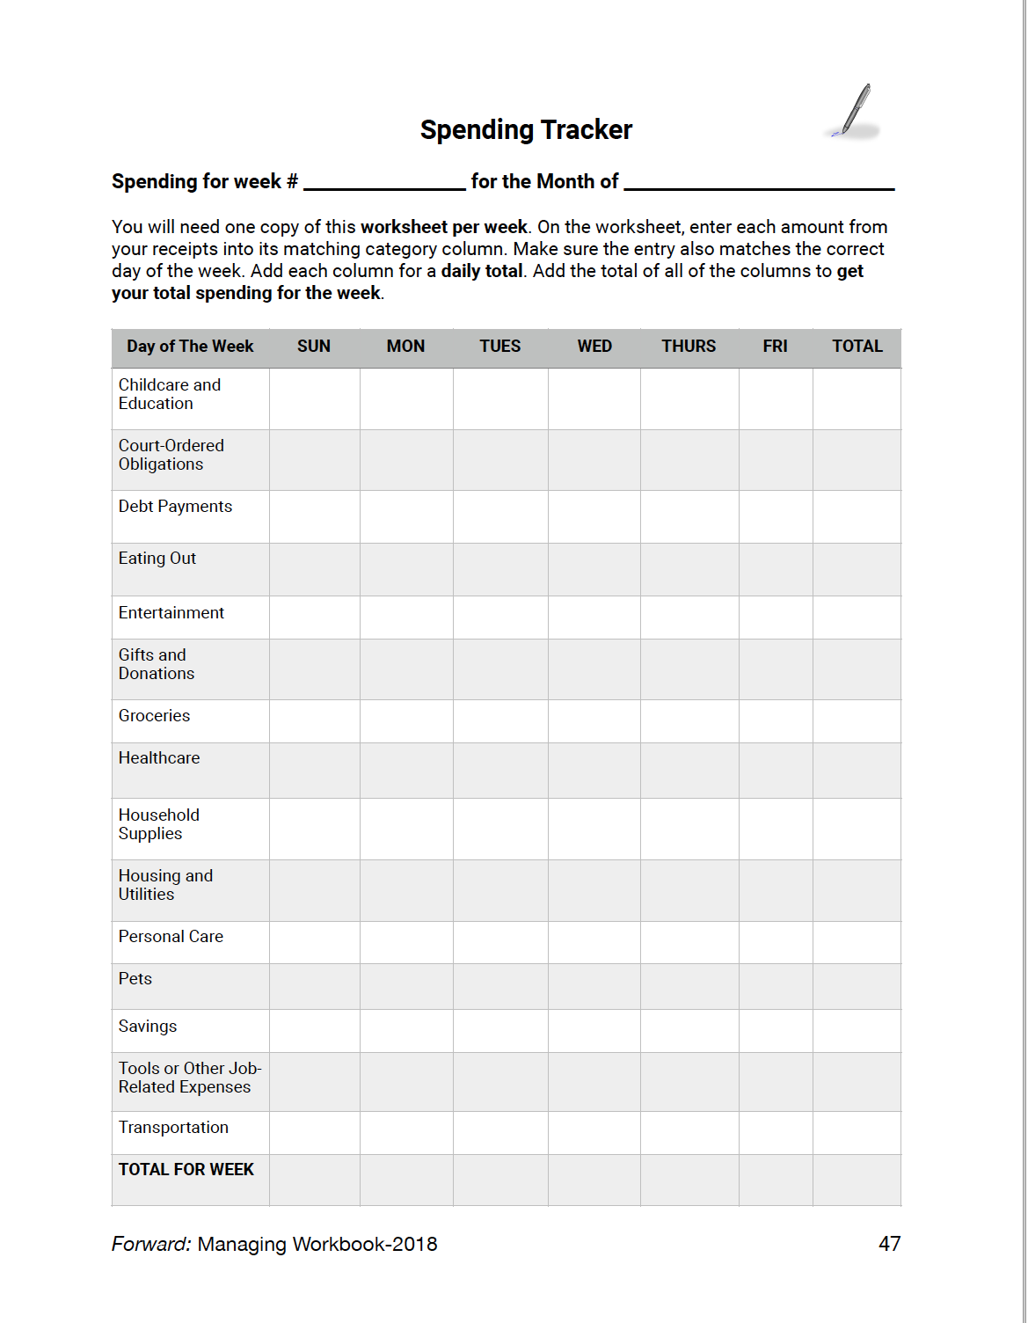
Managing the Life I Want

Slide 19
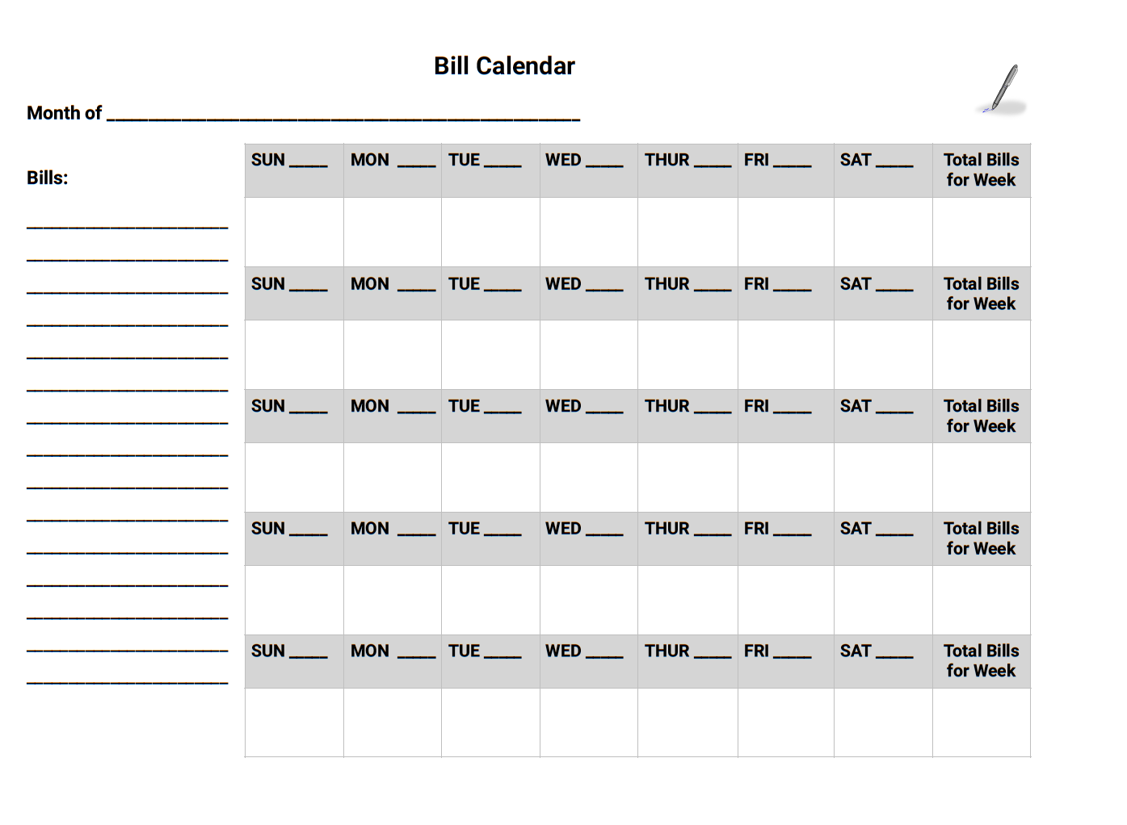
Managing the Life I Want

Slide 20
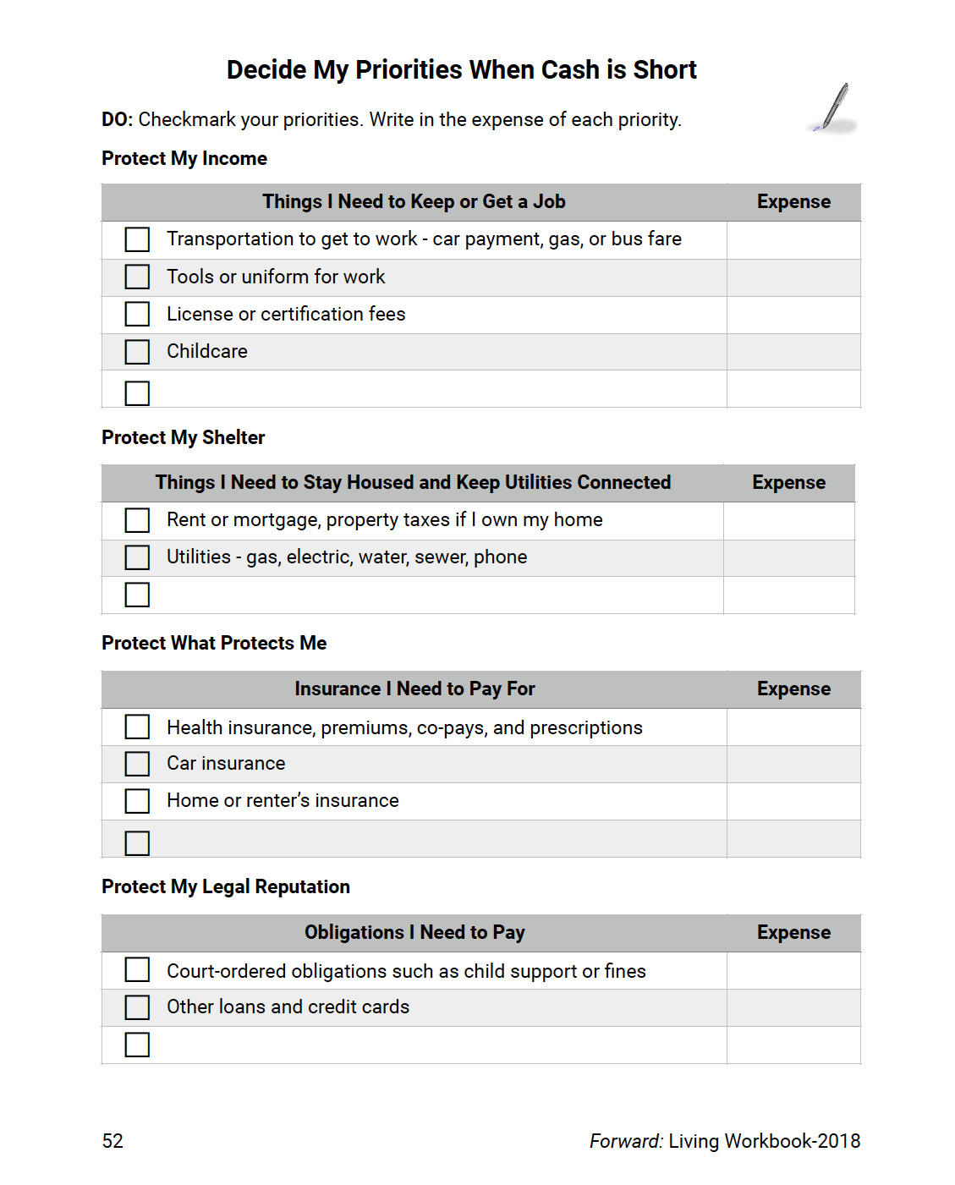
Managing the Life I Want

Slide 21
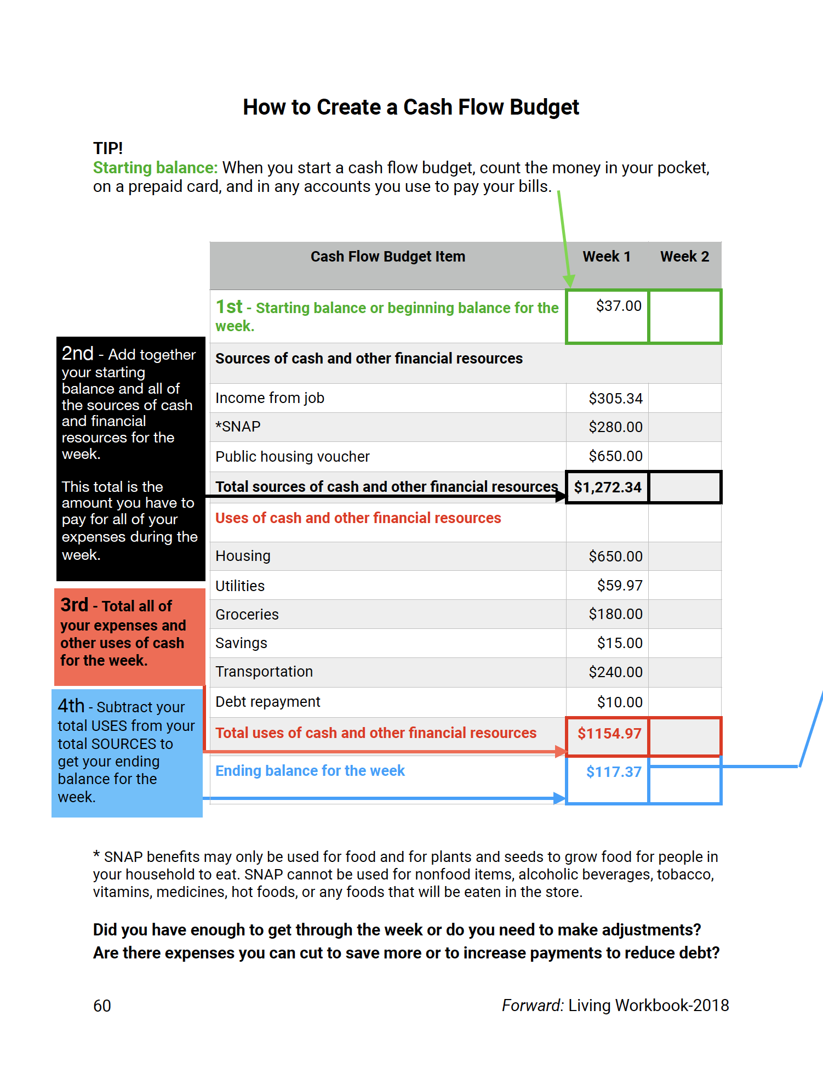
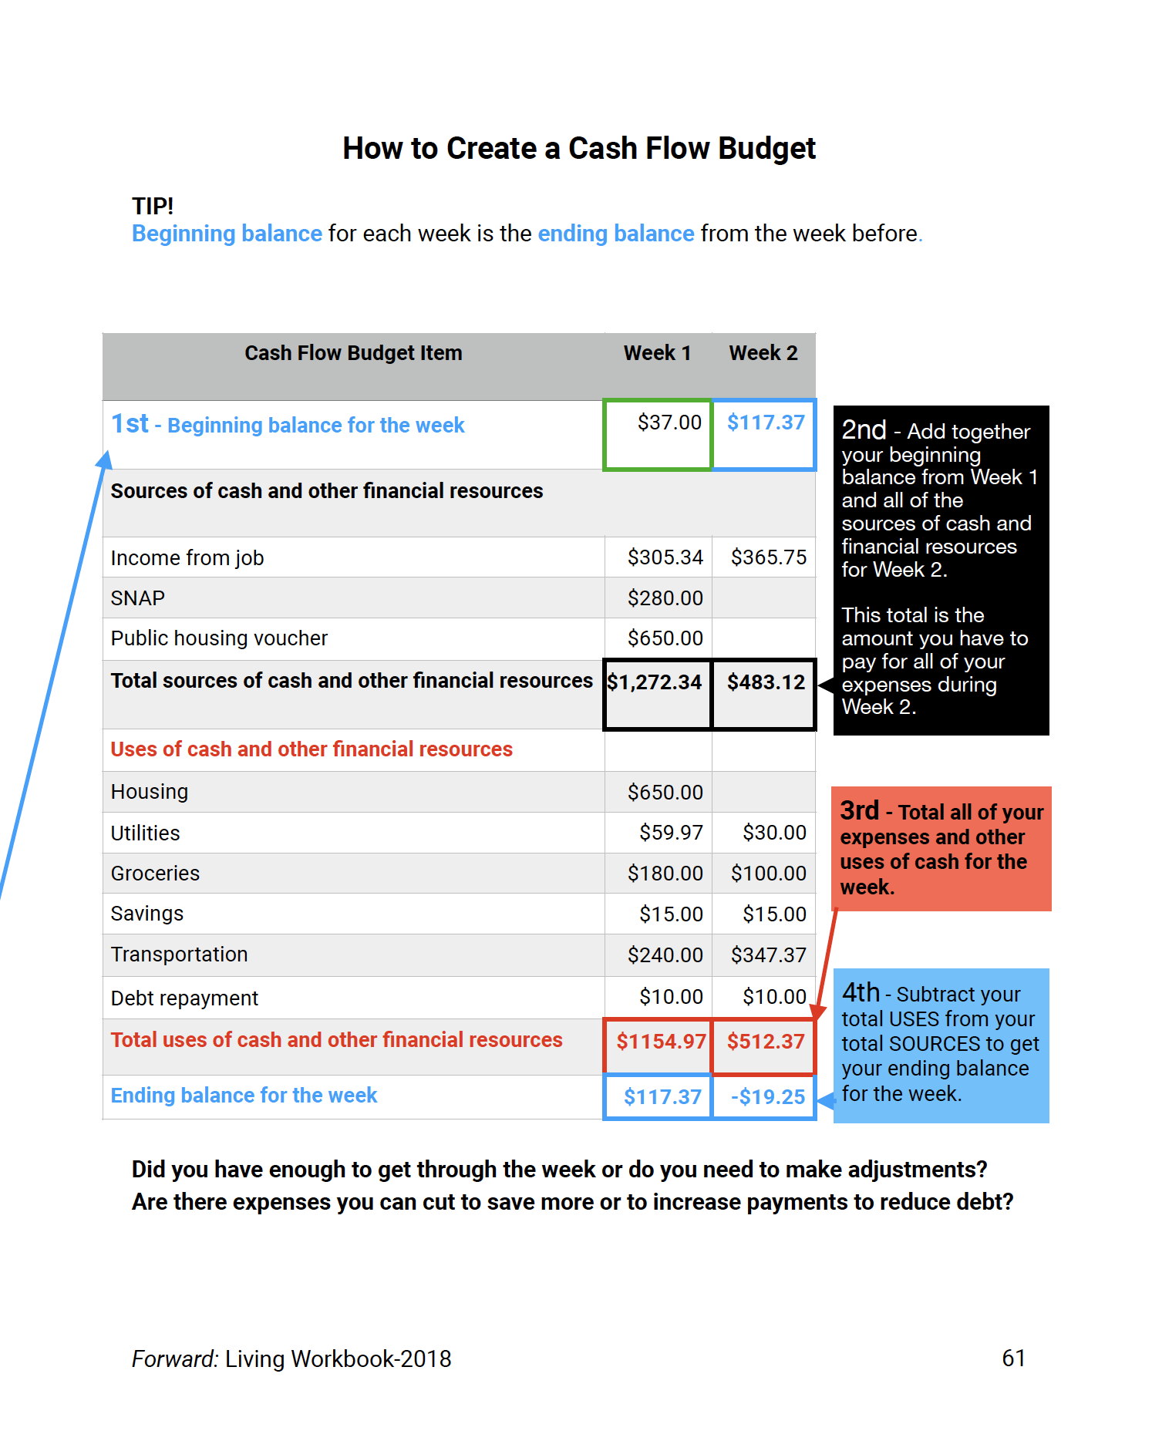
Living the Life I Want

Slide 22
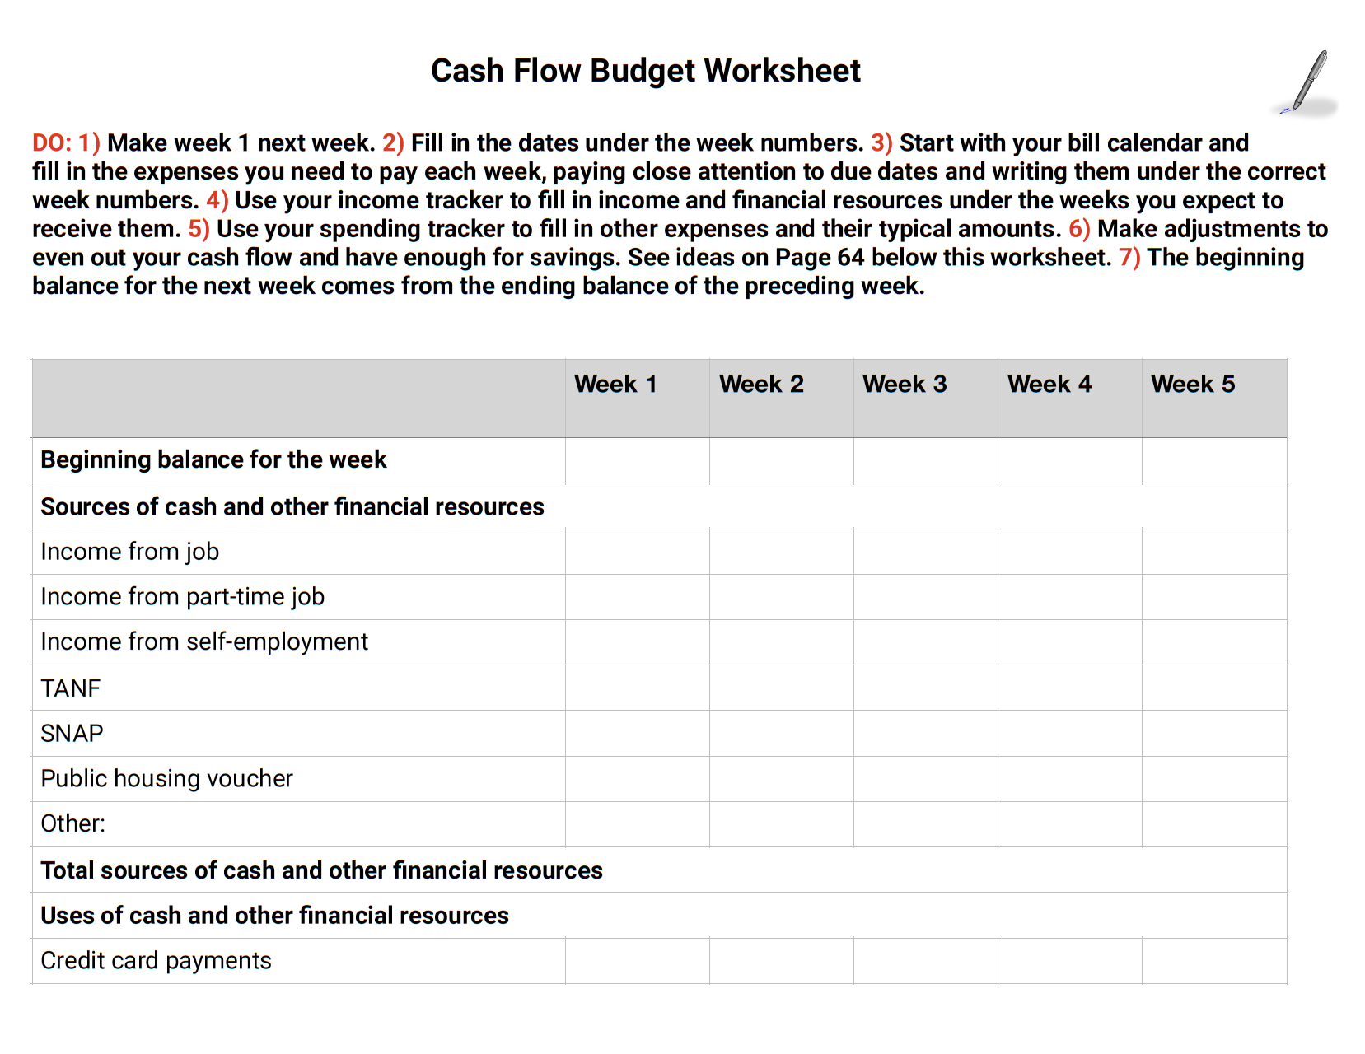
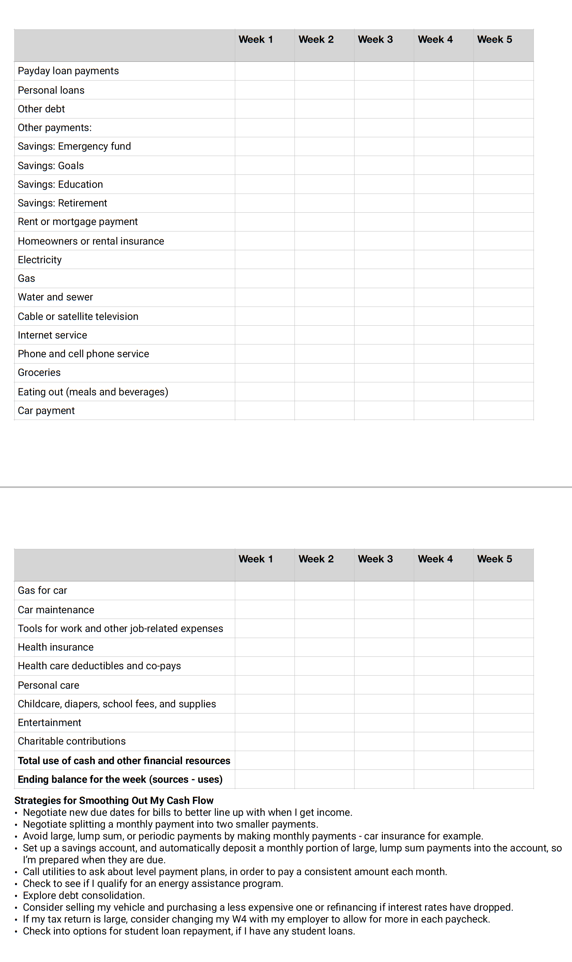
Living the Life I Want

Slide 23
THANK YOU
We’re grateful for your partnership and here to answer any questions as you begin your financial empowerment journey.

